Slide 1
RUSTikales Rust for advanced coders

Slide 2
Plan for today

Slide 3
Plan for today
Recap

Slide 4
Plan for today
Recap
Closures

Slide 5
Plan for today
Recap
Closures
Iterators

Slide 6
Recap

Slide 7
Recap
Procedural Macros are powerful, but difficult to work with

Slide 8
Recap
Procedural Macros are powerful, but difficult to work with
Because they are written in normal Rust, we can use crates

Slide 9
Recap
Procedural Macros are powerful, but difficult to work with
Because they are written in normal Rust, we can use crates
syn and quote are popular crates that help us develop procedural macros
Thanks to them, writing powerful procedural macros becomes almost trivial

Slide 10
Recap
Procedural Macros are powerful, but difficult to work with
Because they are written in normal Rust, we can use crates
syn and quote are popular crates that help us develop procedural macros
Thanks to them, writing powerful procedural macros becomes almost trivial
syn is a Rust parser and converts TokenStreams into convenient data structures

Slide 11
Recap
Procedural Macros are powerful, but difficult to work with
Because they are written in normal Rust, we can use crates
syn and quote are popular crates that help us develop procedural macros
Thanks to them, writing powerful procedural macros becomes almost trivial
syn is a Rust parser and converts TokenStreams into convenient data structures
quote! uses Quasi-Quoting to generate code
We write code, the IDE can perform syntax-highlighting and auto-complete, but the macro uses it as data

Slide 12
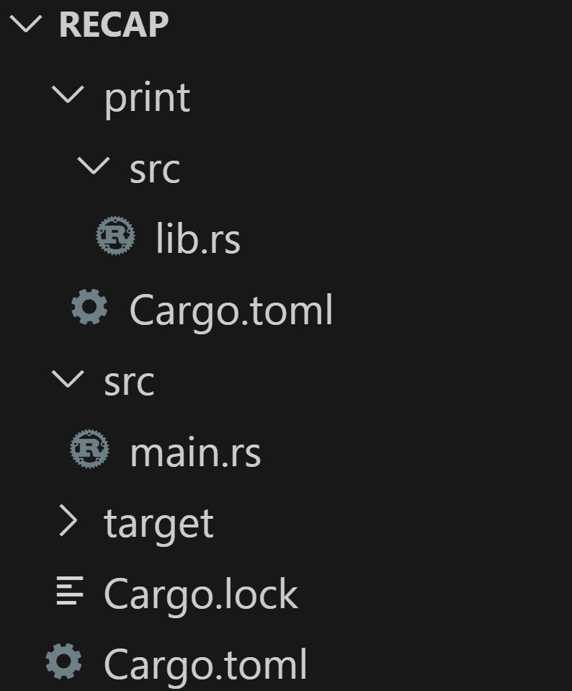
Recap

Slide 13
Recap
Idea:
→ print is a proc-macro crate

Slide 14
Recap
Idea:
→ print is a proc-macro crate
→ In there, we define a proc_macro_attribute which we want to use

Slide 15
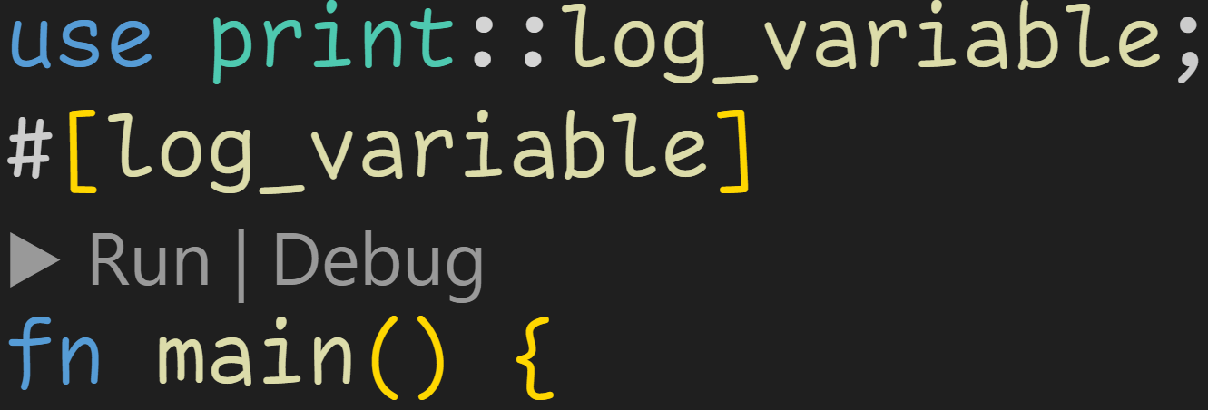
Recap
Idea:
→ print is a proc-macro crate
→ In there, we define a proc_macro_attribute which we want to use
→ We later use that macro in our main application
Usage: Annotate function, it then logs when we declare a variable using let

Slide 16
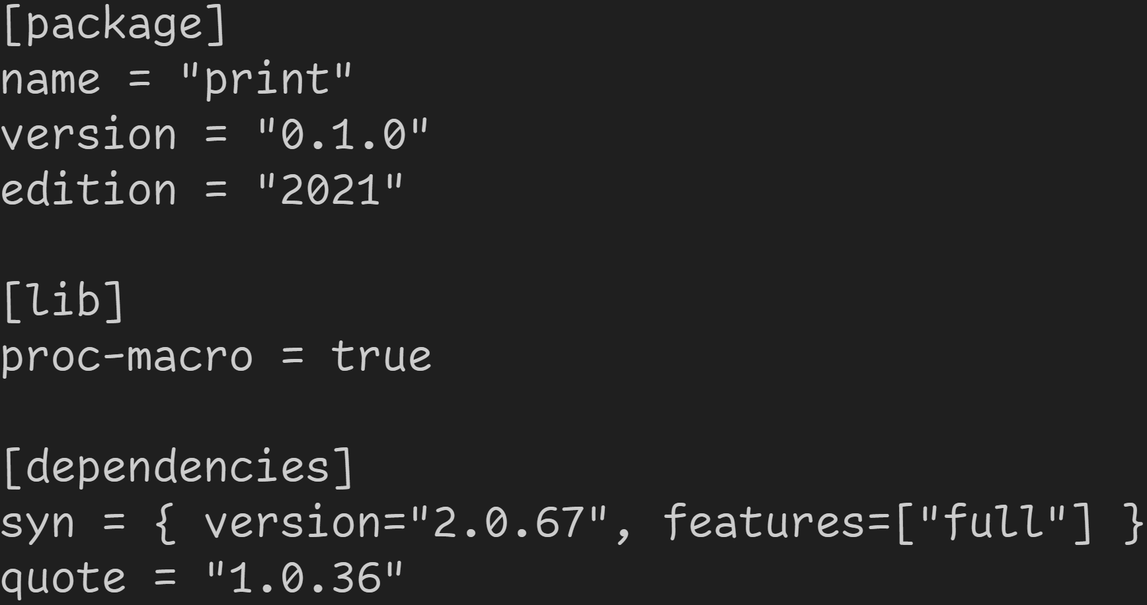
Recap
We are here
Mark crate as proc-macro

Slide 17
Recap
We are here
Use syn and quote like any other crate

Slide 18
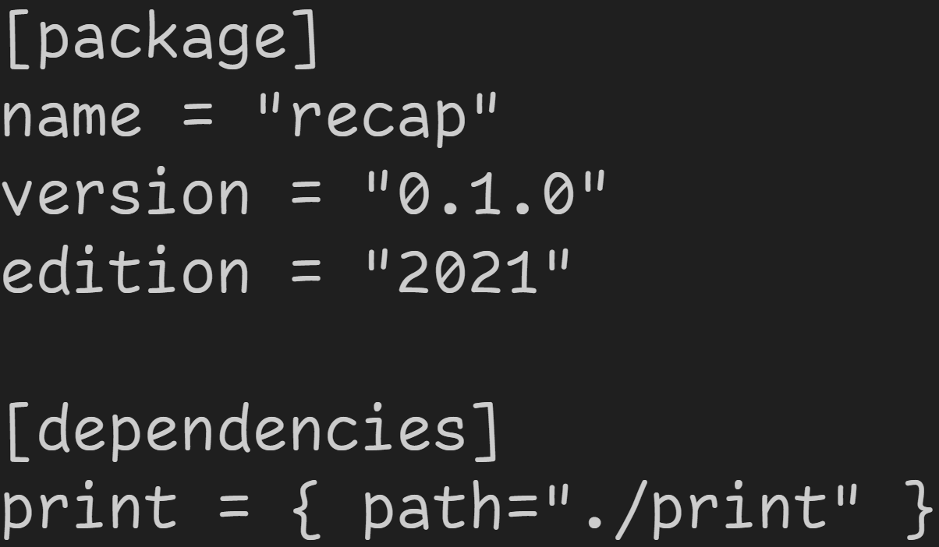
Recap
We are here
use proc-macro in our main application

Slide 19
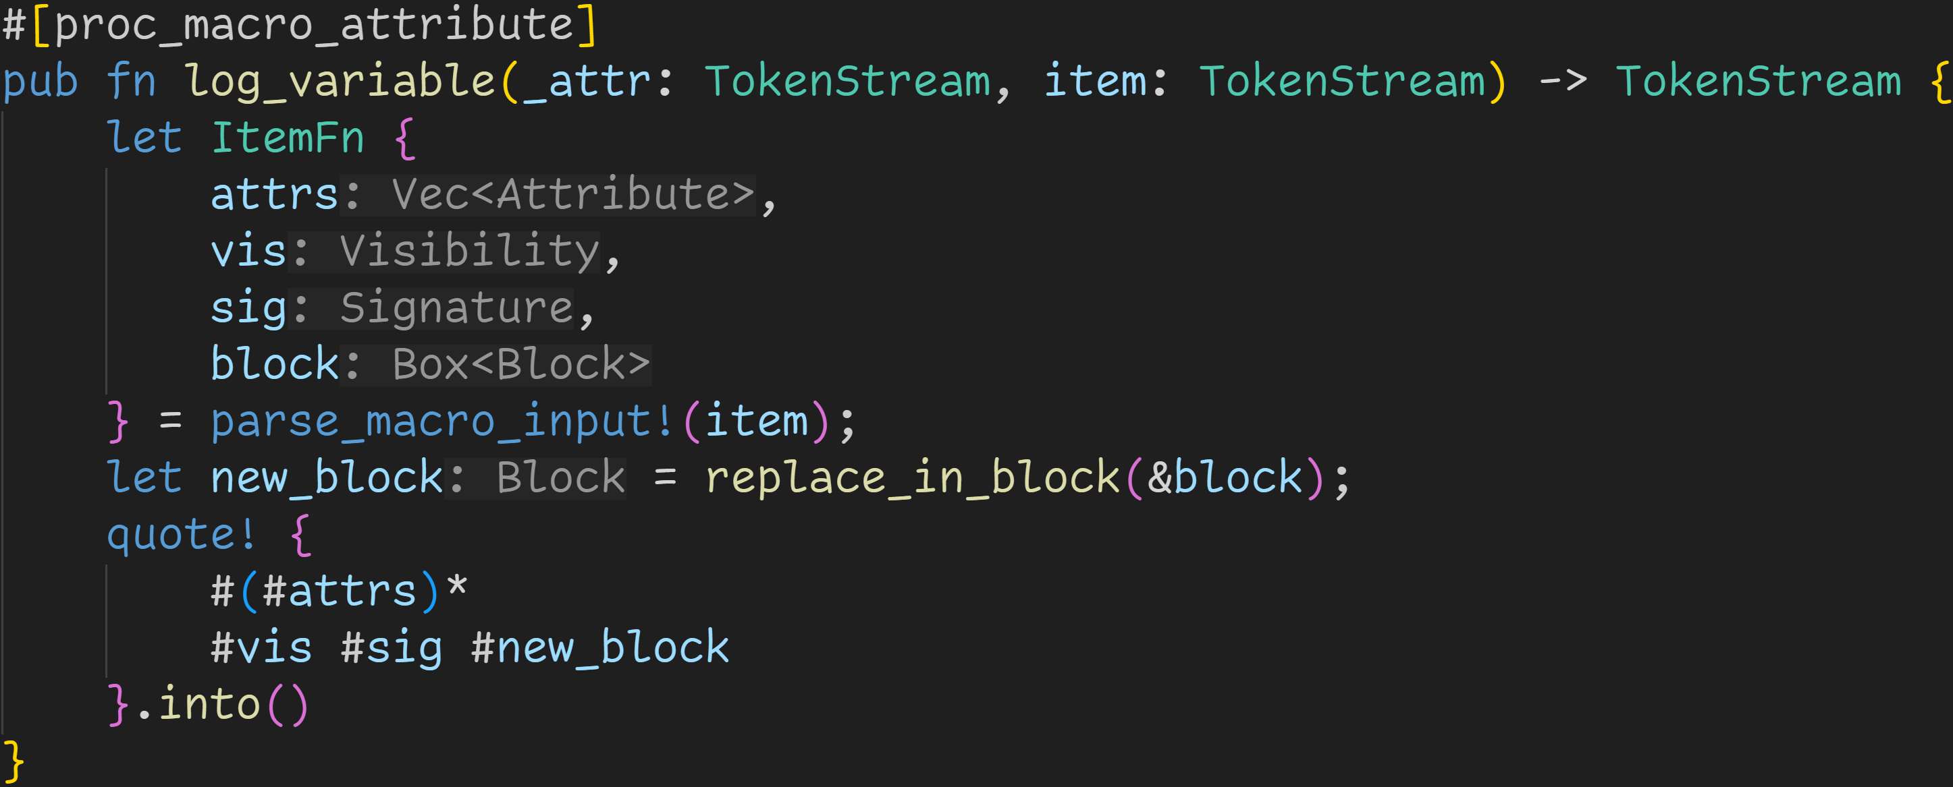
Recap
We are here

Slide 20
Recap
syn allows us to easily parse whatever input we have into any form we want
→ If the given input is not a function, we throw a compiler error
We are here

Slide 21
Recap
syn transforms the input into a data structure, which we can now easily work with
We are here

Slide 22
Recap
We are here
quote! allows us to easily generate code using Quasi-Quoting
→ # interpolates variables defined in the proc-macro and inserts its value into the TokenStream → This macro invocation generates a function for us

Slide 23
Recap
We are here
Combining both crates, we can now easily write macros

Slide 24
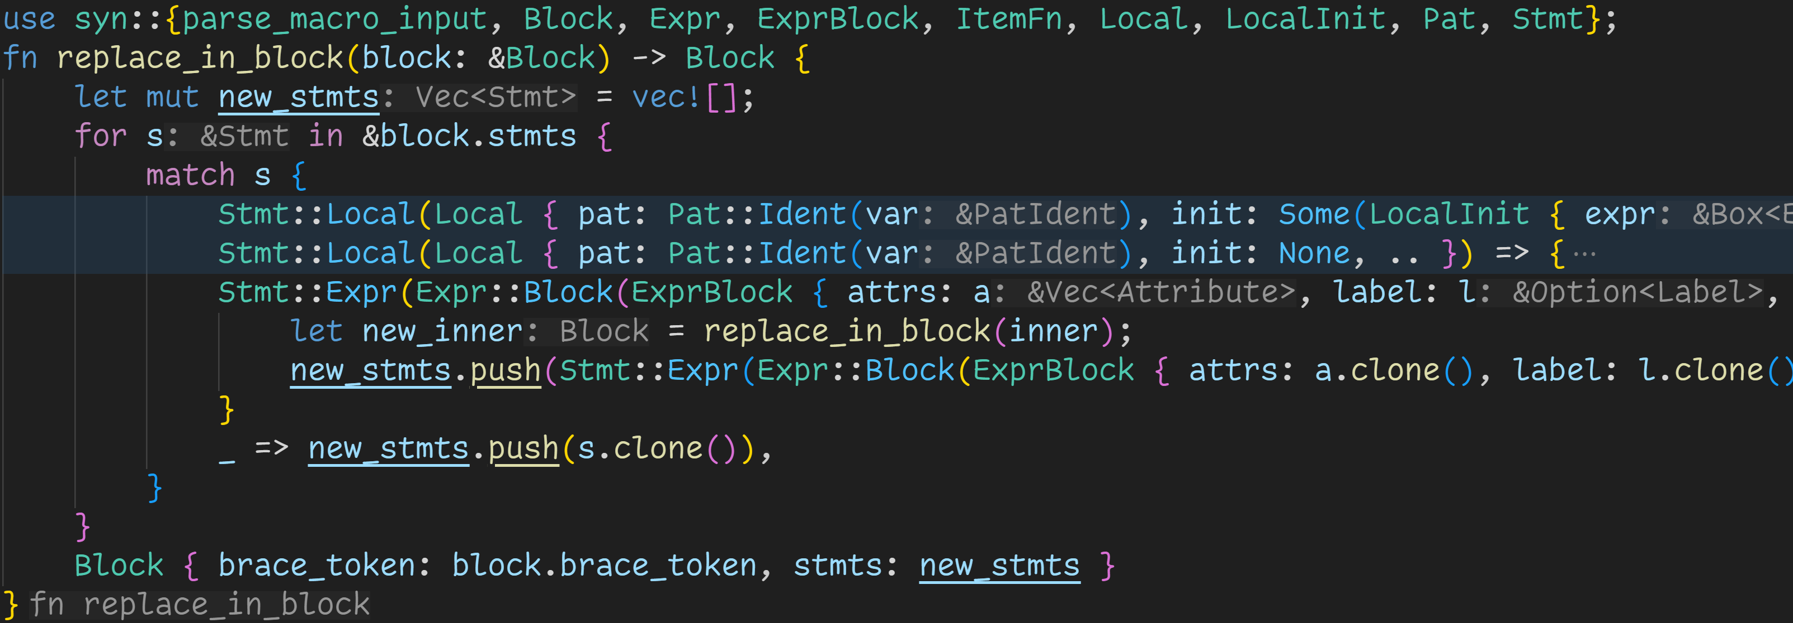
Recap
We are here

Slide 25
Recap
We are here
Idea: Build a new block out of the given input

Slide 26
Recap
We are here
Iterate over all statements, and replace relevant statements with custom behavior

Slide 27
Recap
We are here
Recursively replace all blocks we encounter

Slide 28
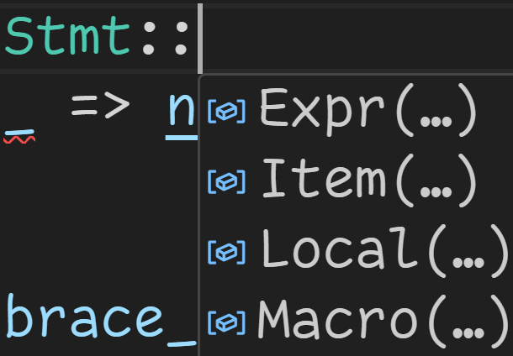
Recap
Rust is expression-based:
→ Everything is an expression (except let) → We don‘t want to replace macros or items
We are here

Slide 29
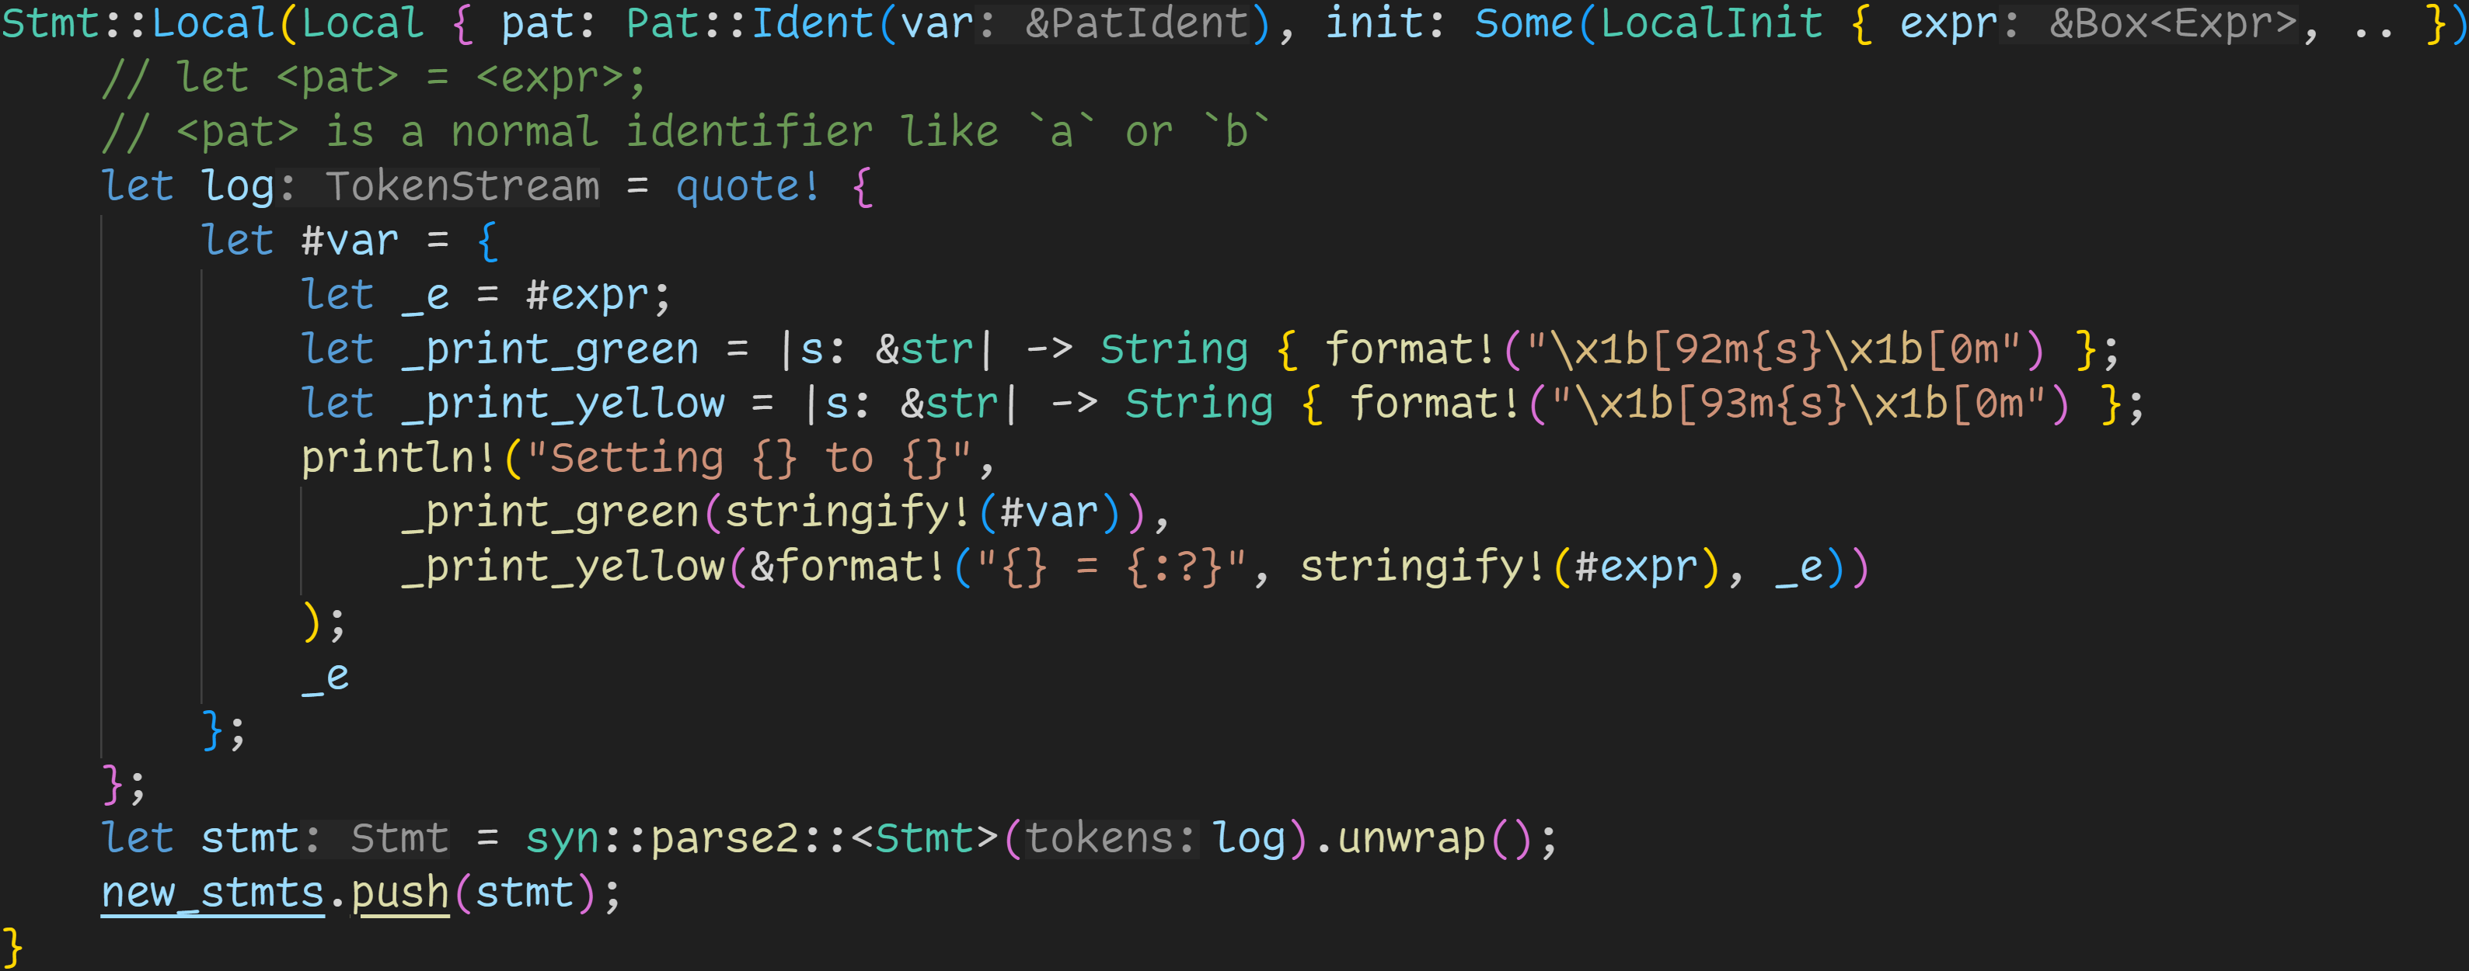
Recap
We are here

Slide 30
Recap
using syn and pattern matching makes developing procedural macros a breeze → If our input doesn‘t have this form, we simply don‘t match that case
We are here

Slide 31
Recap
We are here
Using quote! also really helps, here:
→ Replace original <expr> with a big block, where we print our custom info

Slide 32
Recap
We are here
We declare local helper variables
→ Will be visible when using cargo expand

Slide 33
Recap
We are here
Convention: Prefix helper variables with _
→ Disables unused-warnings
→ Prevents name clashes and variable shadowing

Slide 34
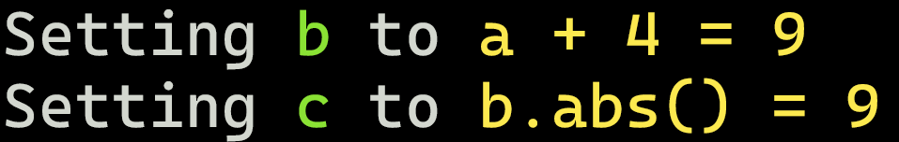
Recap
at runtime, we print this
We are here

Slide 35
Recap
We are here
Parsing is a bit redundant, but we‘re building a vector of statements → Our generated code → We know it‘s correct → We can easily unwrap

Slide 36
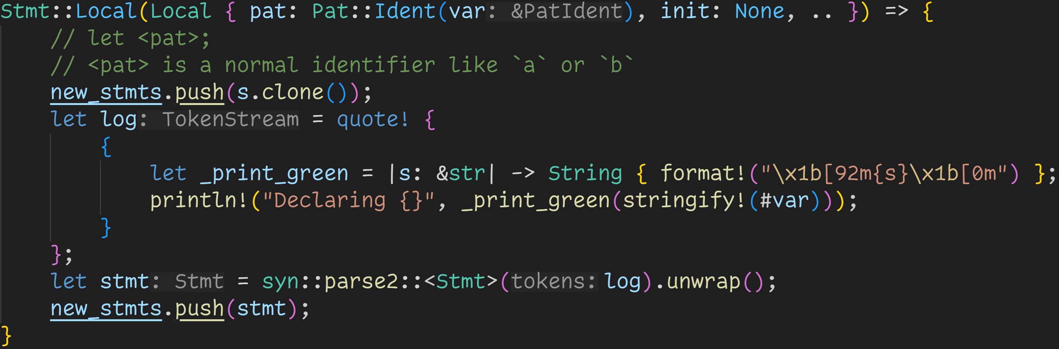
Recap
We are here

Slide 37
Recap
We are here
Simpler this time, we just log that we declared a variable

Slide 38

Recap
We are here

Slide 39
Recap
We are here
Generate code

Slide 40
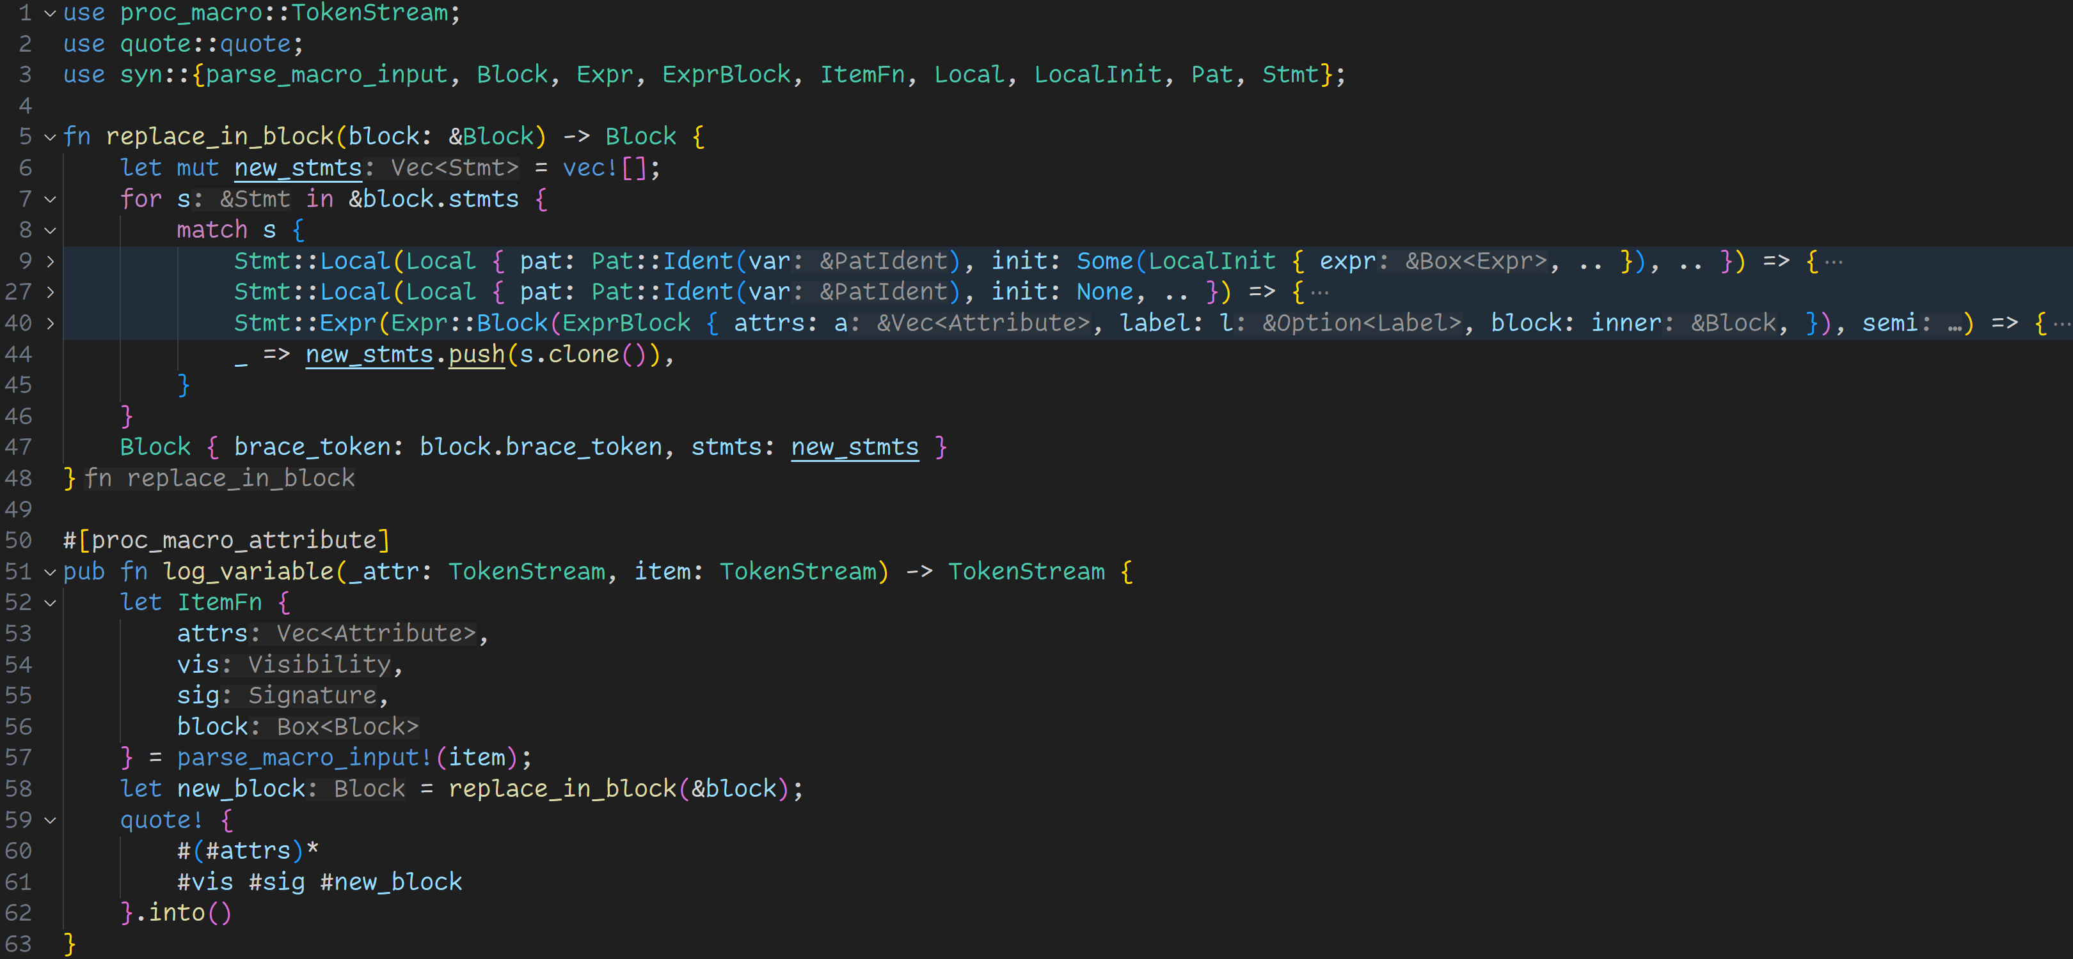
And that‘s it!

Slide 41
And that‘s it!
→ We only needed 60 lines of code to write this macro
→ We can now log every variable declaration in any function!

Slide 42
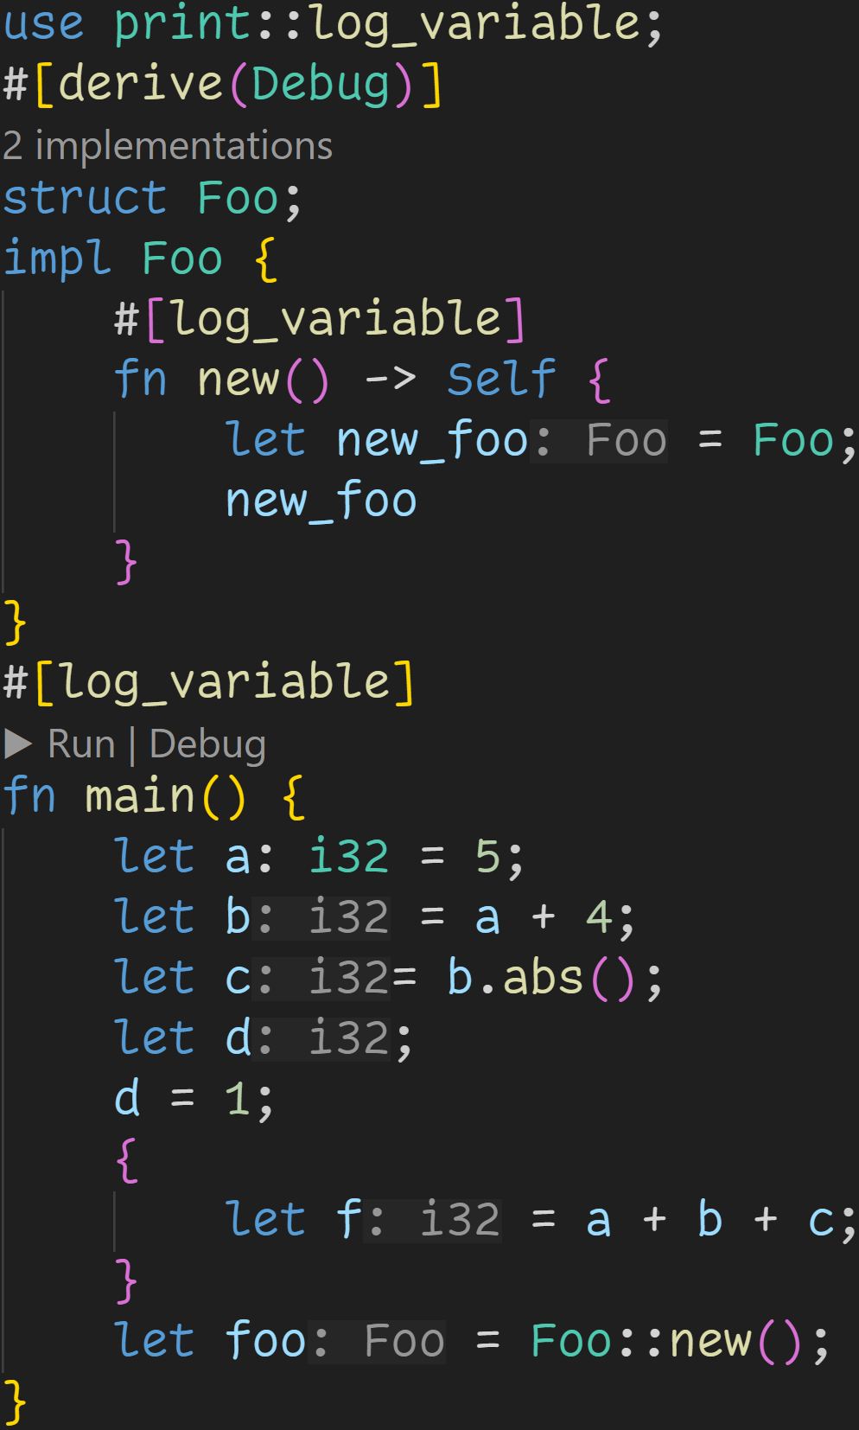

Slide 43
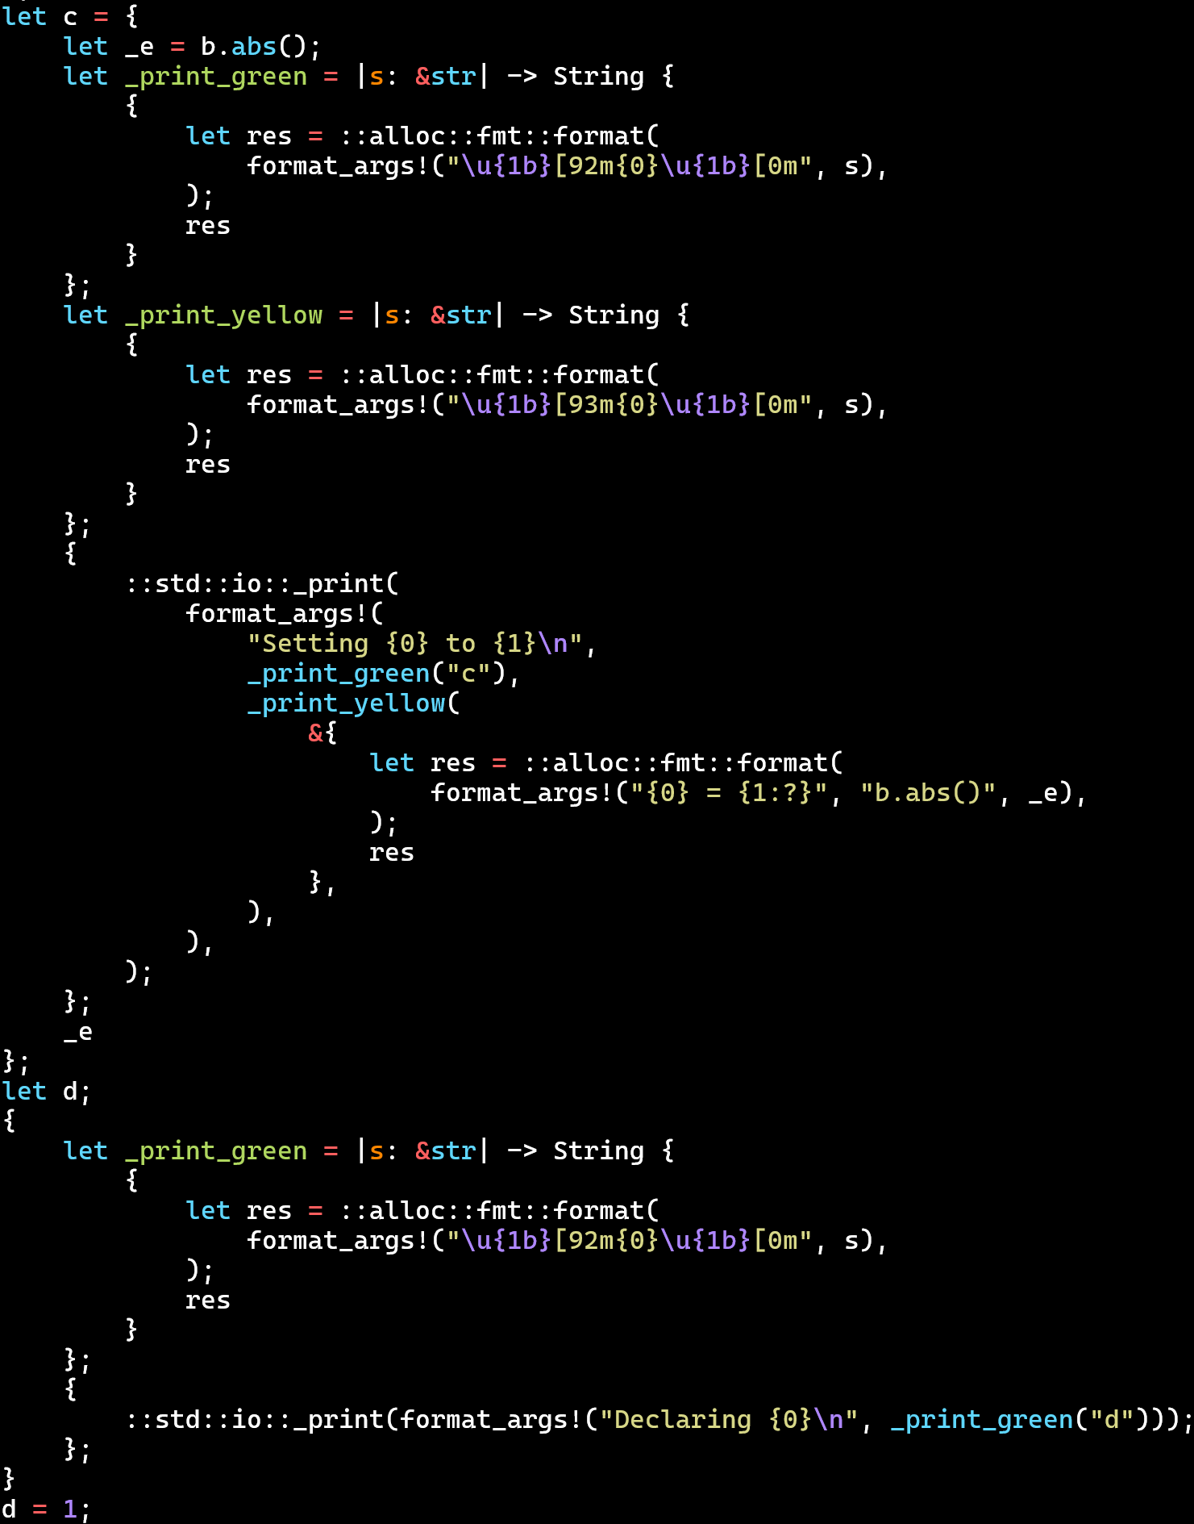
cargo expand

Slide 44
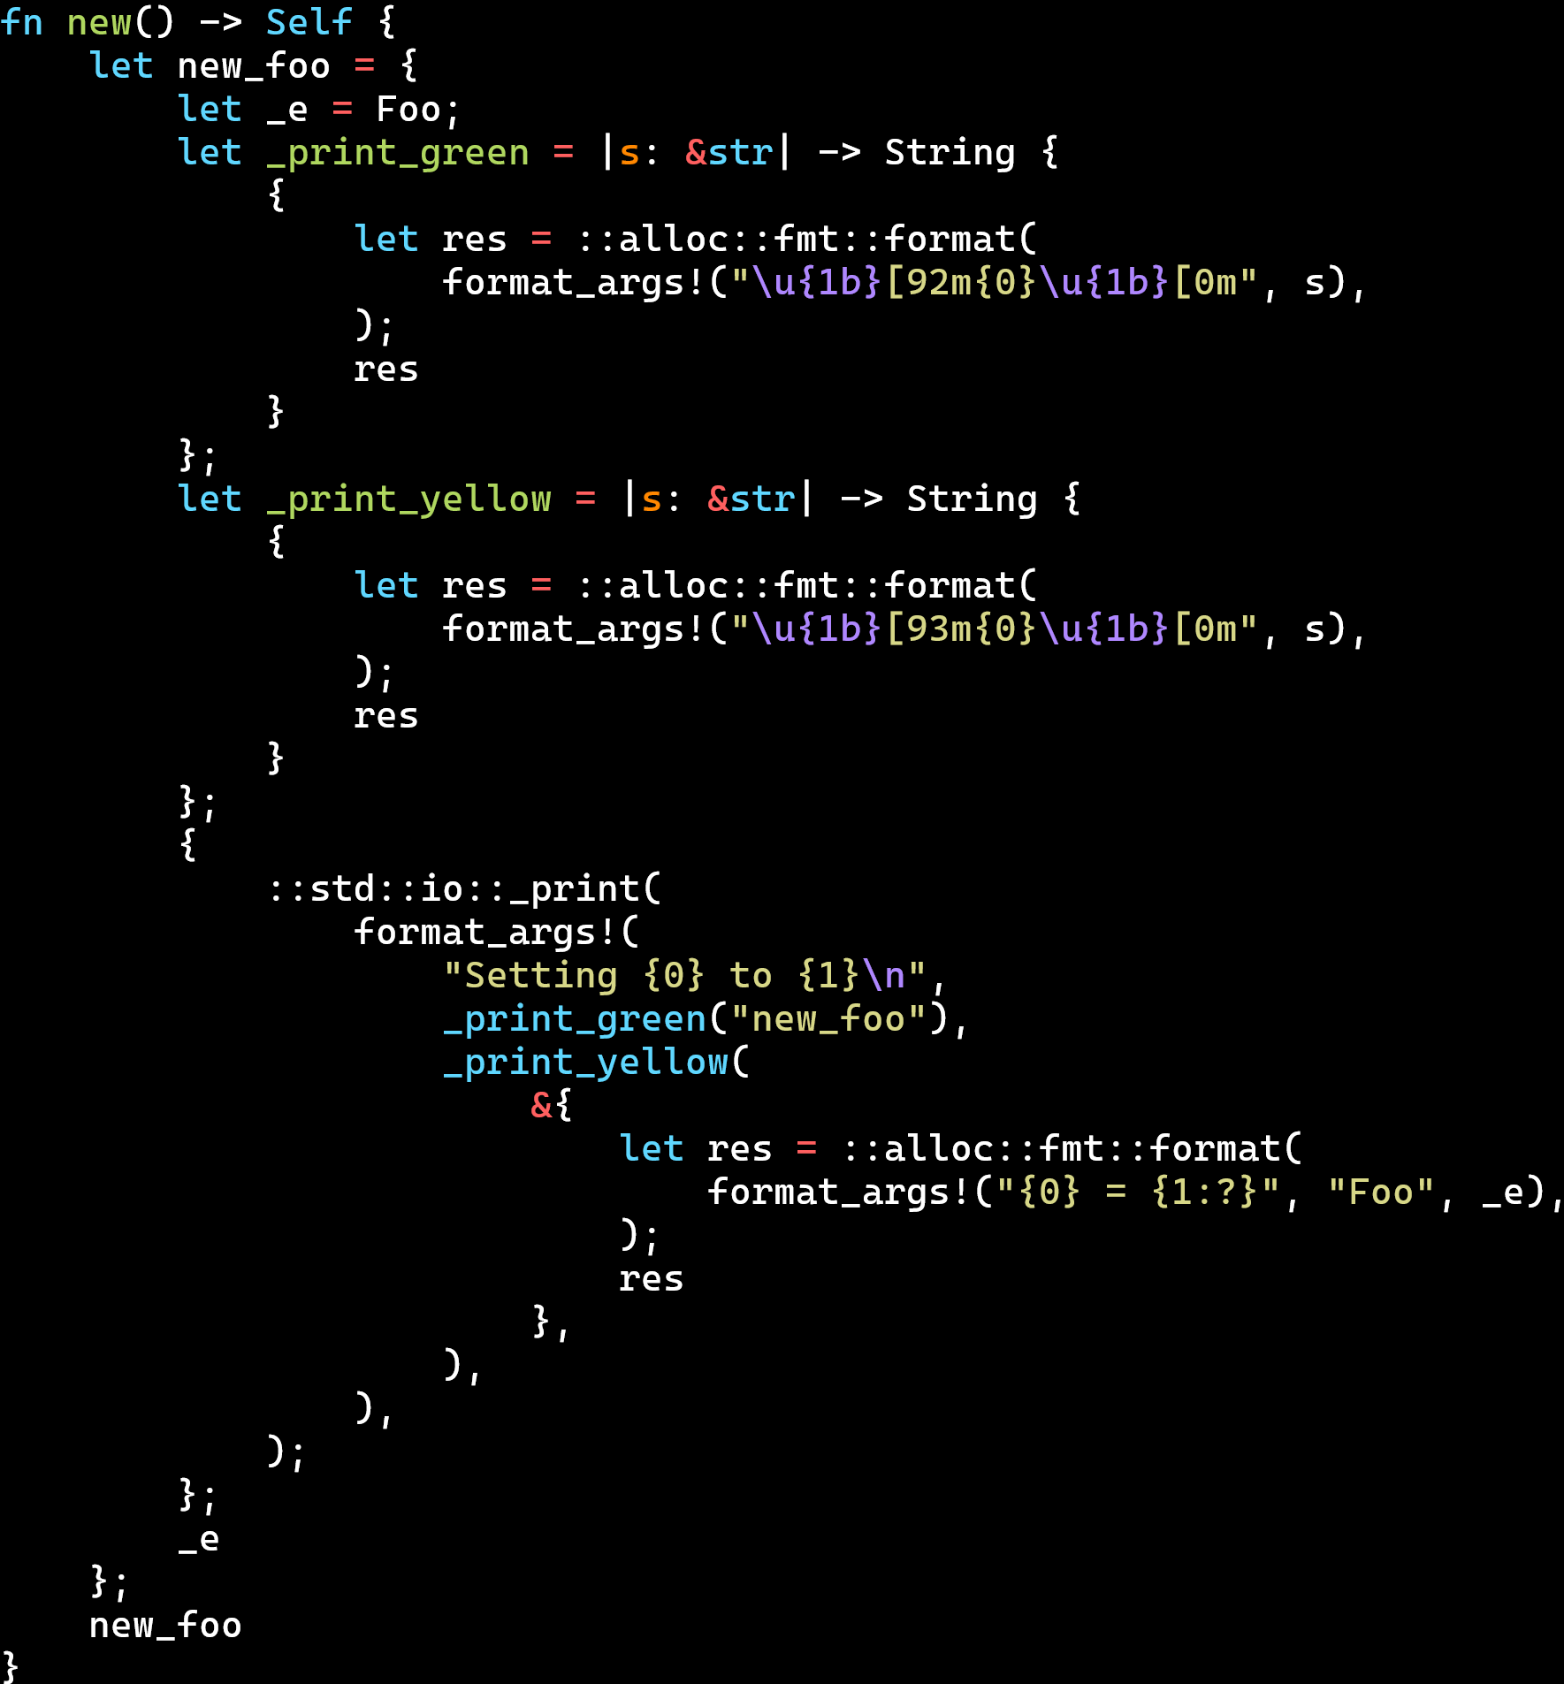
cargo expand

Slide 45
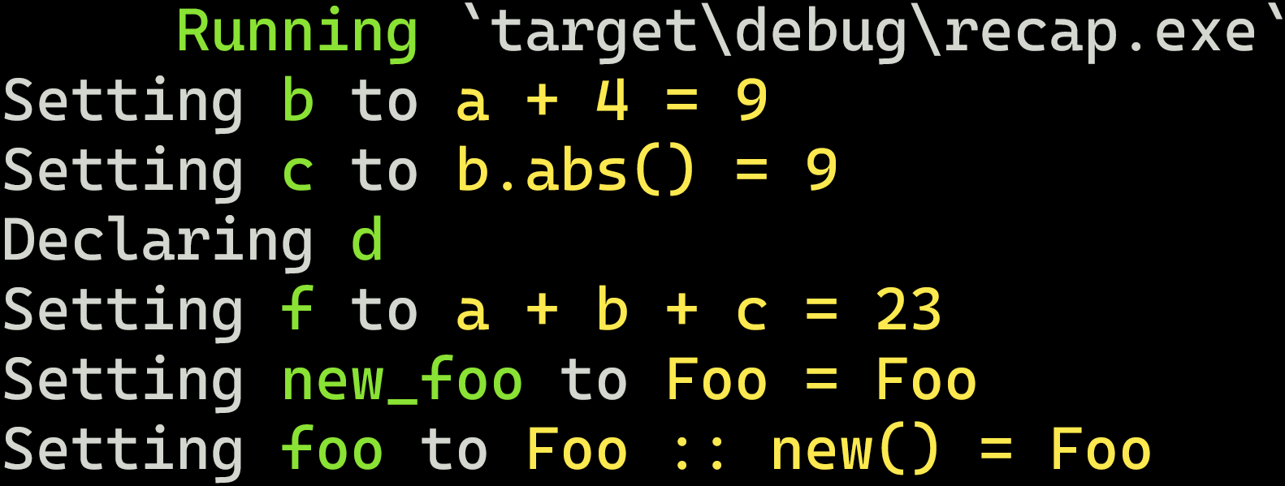
cargo run

Slide 46
cargo run
a: i32 is Pat::Type, not Pat::Ident, so we don‘t log that :^)

Slide 47
Closures

Slide 48
Closures
Rust has various properties that make it a functional programming language

Slide 49
Closures
Rust has various properties that make it a functional programming language
Functional programming:

Slide 50
Closures
Rust has various properties that make it a functional programming language
Functional programming:
Programs are constructed by applying and composing functions

Slide 51
Closures
Rust has various properties that make it a functional programming language
Functional programming:
Programs are constructed by applying and composing functions
Functions are first-class citizen

Slide 52
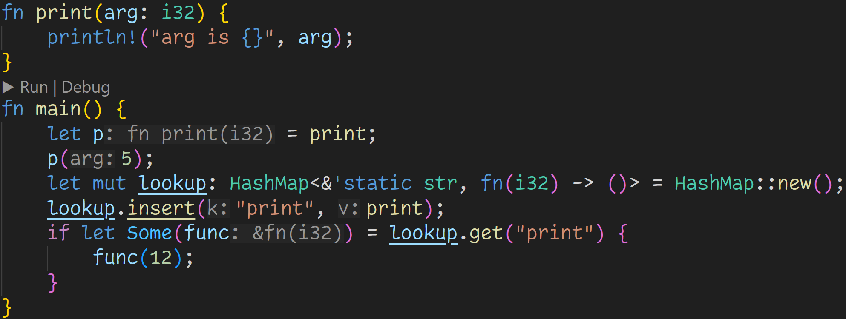
Closures

Slide 53
Closures
Functions in Rust are first-class citizen
→ We can do everything with functions that we can do with normal variables

Slide 54
Closures
Functions in Rust are first-class citizen
→ We can do everything with functions that we can do with normal variables
We can assign functions to variables

Slide 55
Closures
Functions in Rust are first-class citizen
→ We can do everything with functions that we can do with normal variables
We can put functions into data structures

Slide 56
Closures
Functions in Rust are first-class citizen
→ We can do everything with functions that we can do with normal variables
both p and func are pointers to the original function → Indirect function call

Slide 57
Closures
Functions in Rust are first-class citizen
→ We can do everything with functions that we can do with normal variables
Type signature for functions

Slide 58
Closures
Type signature for functions
Those types are the same

Slide 59
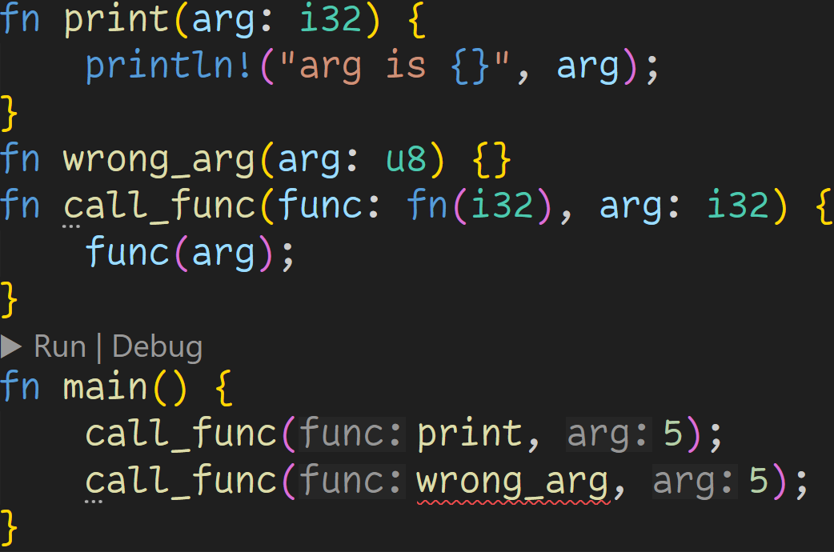
Closures

Slide 60
Closures
We can pass functions as arguments

Slide 61
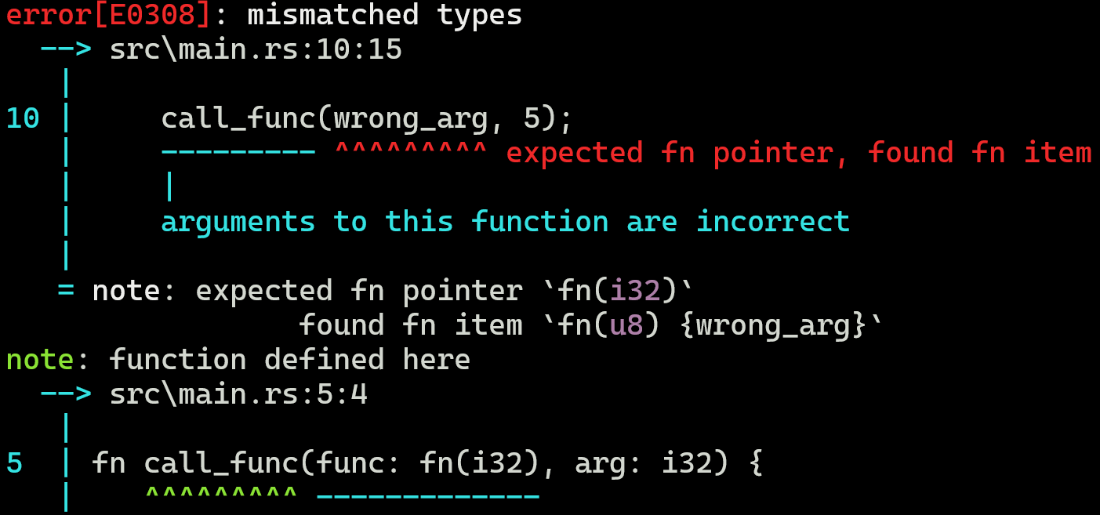
Closures
Everything is checked at compile time

Slide 62
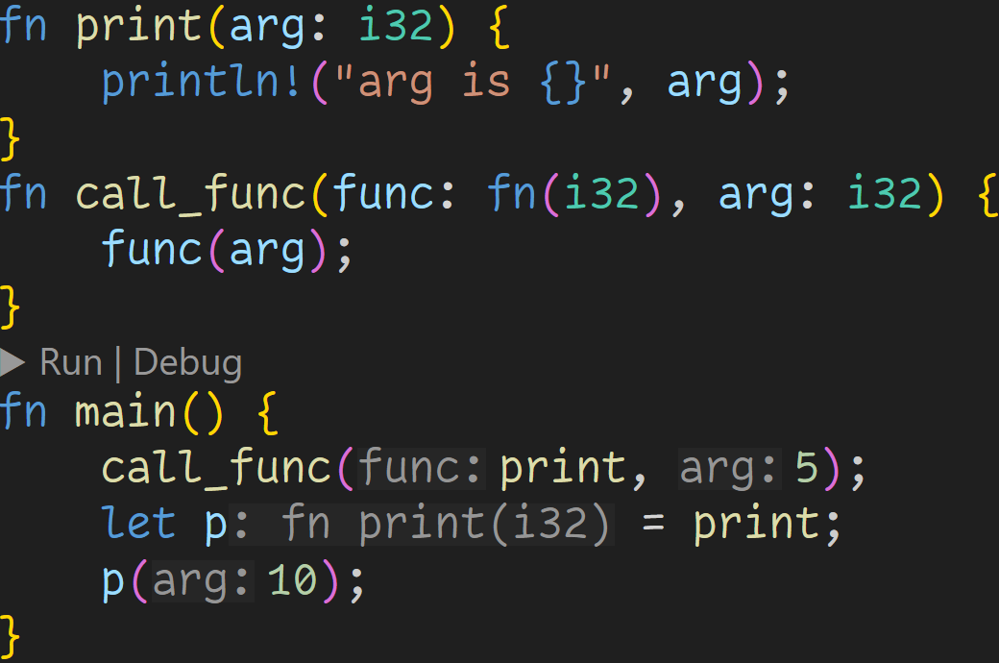
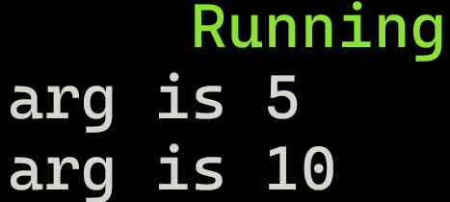
Closures

Slide 63
Closures

Slide 64
Closures

Slide 65
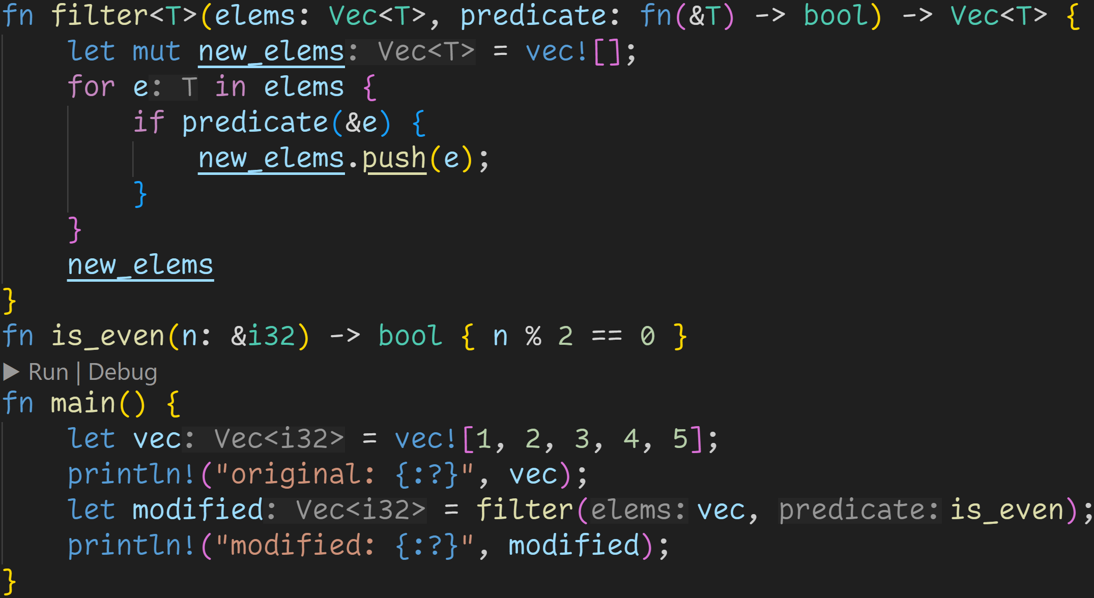
Closures

Slide 66
Closures
By accepting functions as parameters, we can now build higher-level functions
→ filter: Take a list, and collect all elements which satisfy a given predicate

Slide 67
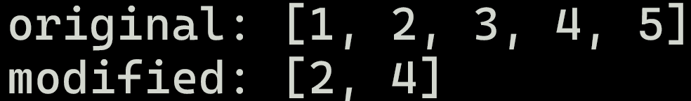
Closures
modified contains all even elements of vec

Slide 68
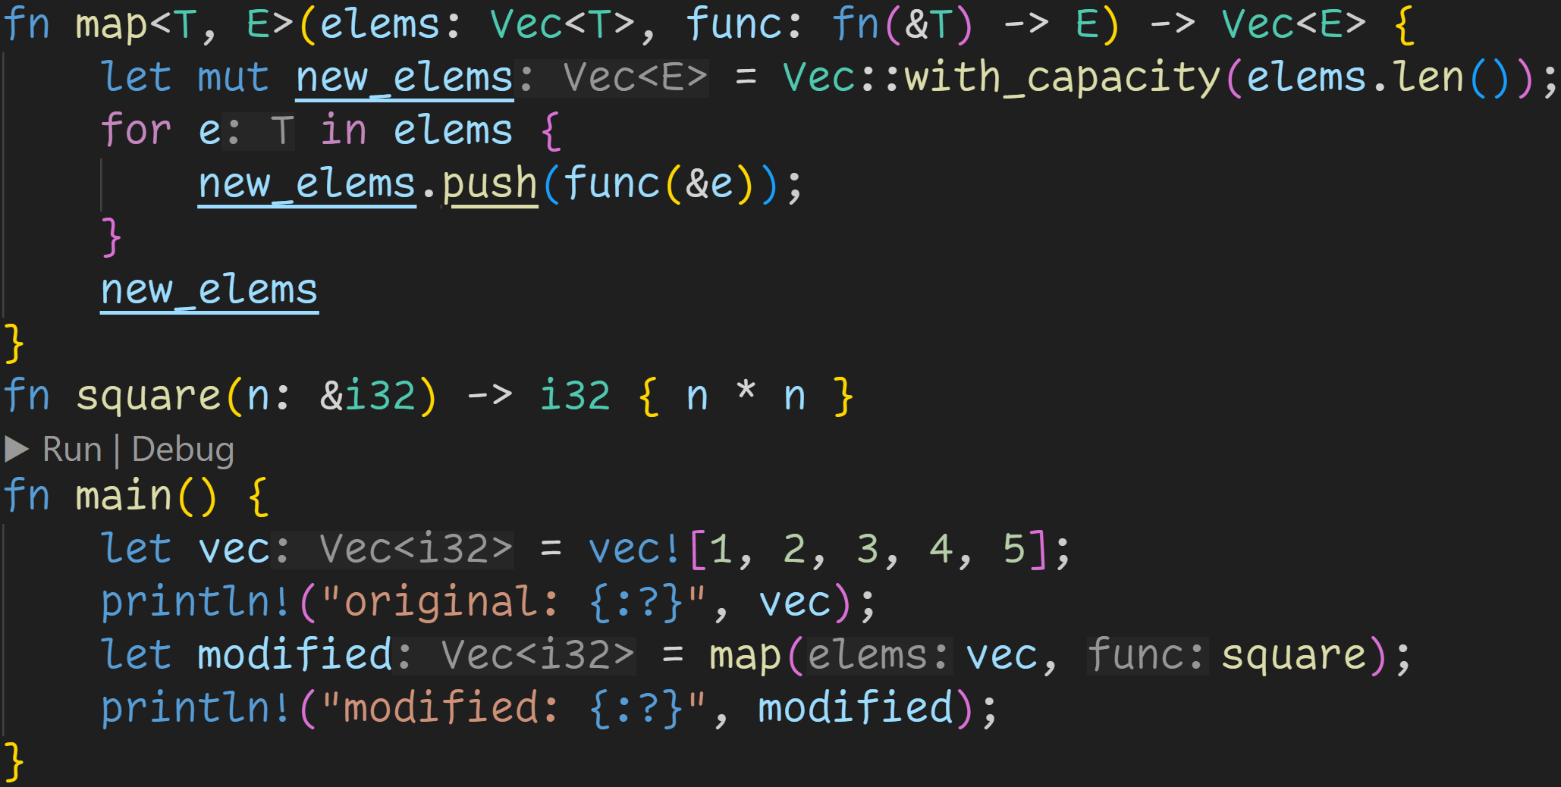
Closures

Slide 69
Closures
By accepting functions as parameters, we can now build higher-level functions: → map: Take a list, and apply a function to all elements

Slide 70
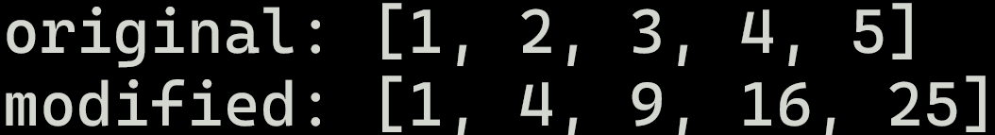
Closures
modified contains the first five square numbers

Slide 71
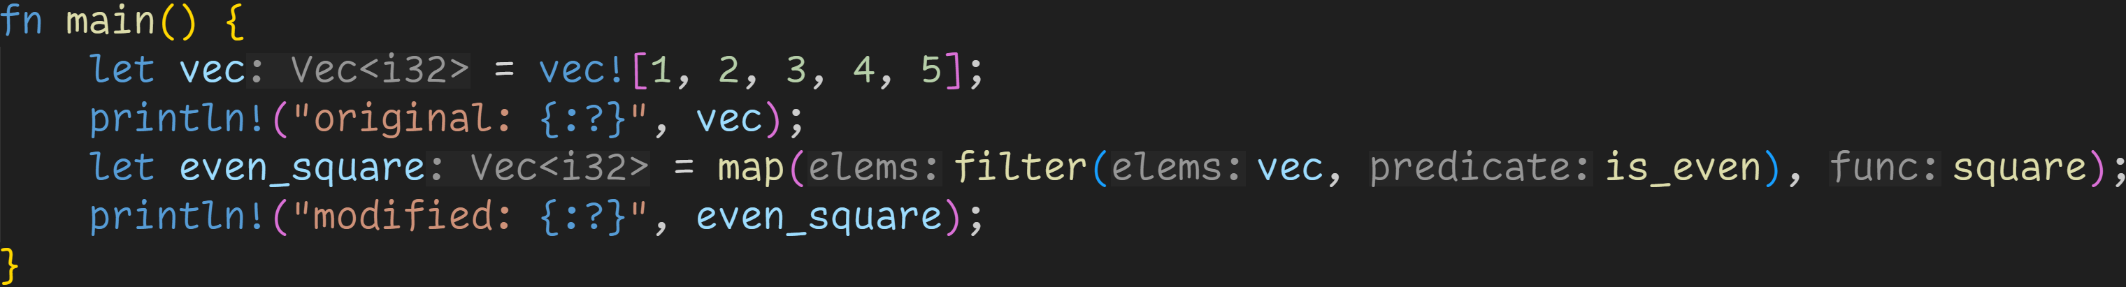
Closures

Slide 72
Closures
Composition means passing the output of one function directly to the next function
→ Filter our original vector, only keep the even numbers, which we square directly after

Slide 73
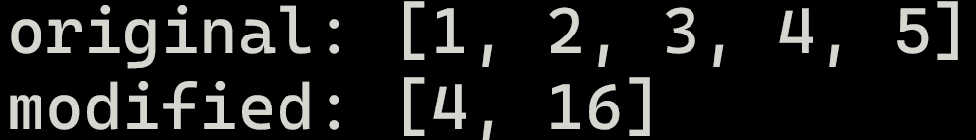
Closures
Composition means passing the output of one function directly to the next function
→ Filter our original vector, only keep the even numbers, which we square directly after

Slide 74
Closures
This is not ideal though, we need to think about function names for our predicates
→ Rust does not support function overloading, we can only have one is_even and one square → What if the actual square-function should serve a different purpose?

Slide 75
Closures
Closures are special expressions that declare anonymous functions
Anonymous function → Closures have no name

Slide 76
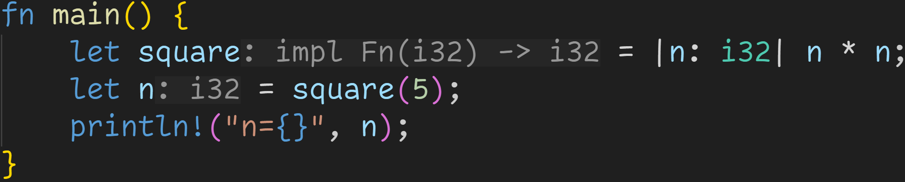
Closures
Closures are special expressions that declare anonymous functions
Anonymous function → Closures have no name

Slide 77
Closures
Closures are special expressions that declare anonymous functions
Anonymous function → Closures have no name
This is a closure

Slide 78
Closures
Closures are special expressions that declare anonymous functions
Anonymous function → Closures have no name
Parameters are declared between the pipes

Slide 79
Closures
Closures are special expressions that declare anonymous functions
Anonymous function → Closures have no name
Closure body
→ Can also be a block {}

Slide 80
Closures
Closures are special expressions that declare anonymous functions
Anonymous function → Closures have no name
We can now bind the closure to a variable, and call it like a normal function

Slide 81
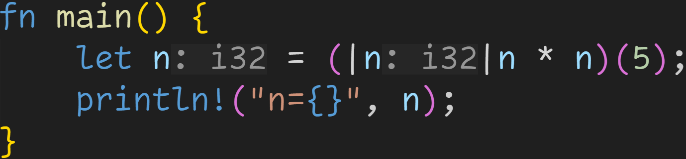
Closures
Closures are special expressions that declare anonymous functions
Anonymous function → Closures have no name
We can also directly call the closure

Slide 82
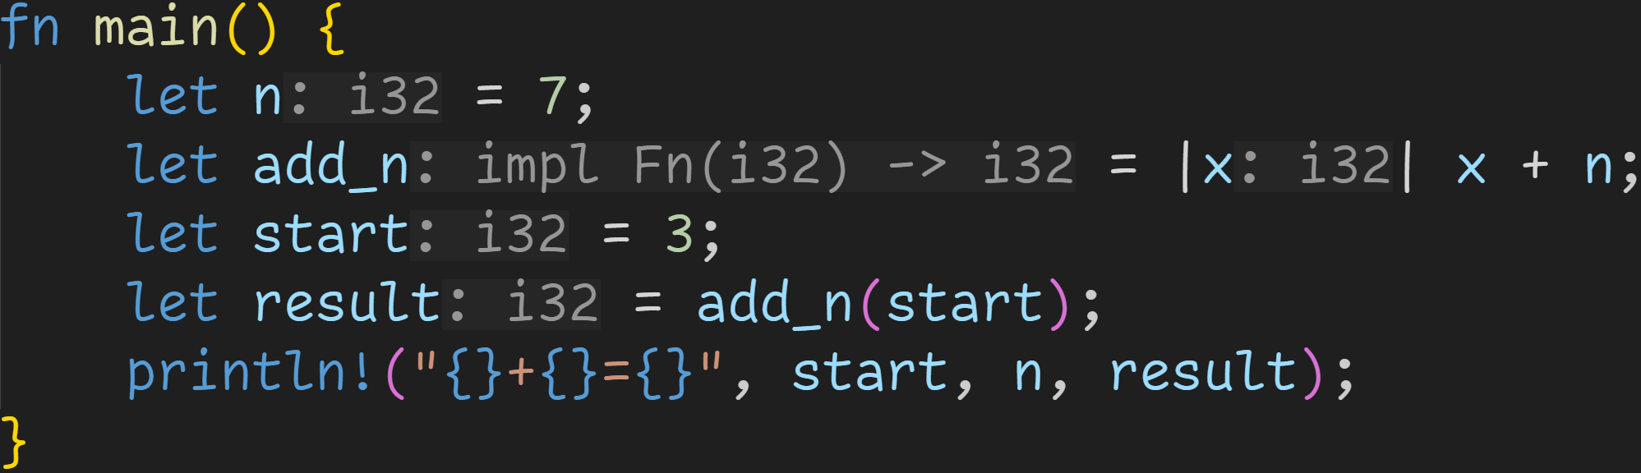
Closures

Slide 83
Closures
Closures are more powerful than function pointers
→ They allow us to capture and use local variables

Slide 84
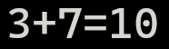
Closures
Closure computes x + 7

Slide 85
Closures
Closures implement a special trait that defines their behavior

Slide 86
Closures
There are three traits that a closure can implement → Fn, FnMut, FnOnce

Slide 87
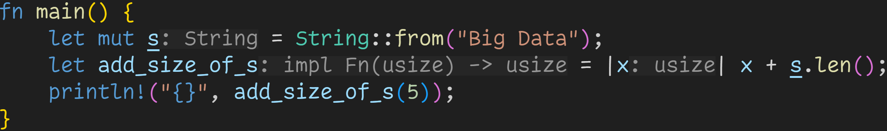
Closures
There are three traits that a closure can implement → Fn, FnMut, FnOnce

Slide 88
Closures
There are three traits that a closure can implement → Fn, FnMut, FnOnce
If we only ever immutably borrow outer variables, the closure implements Fn

Slide 89
Closures
There are three traits that a closure can implement → Fn, FnMut, FnOnce
If we only ever immutably borrow outer variables, the closure implements Fn
In this range we immutably borrow s

Slide 90
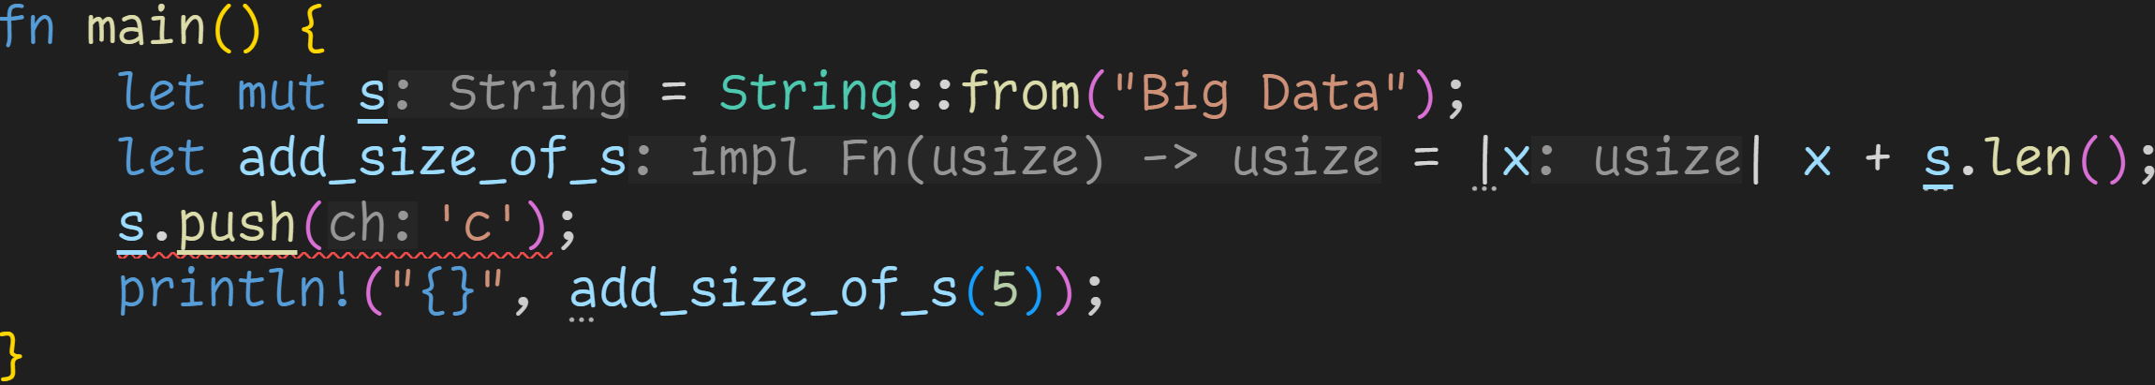
Closures
There are three traits that a closure can implement → Fn, FnMut, FnOnce

Slide 91
Closures
There are three traits that a closure can implement → Fn, FnMut, FnOnce
Immutable borrow here

Slide 92
Closures
There are three traits that a closure can implement → Fn, FnMut, FnOnce
Mutable borrow here
Immutable borrow here

Slide 93
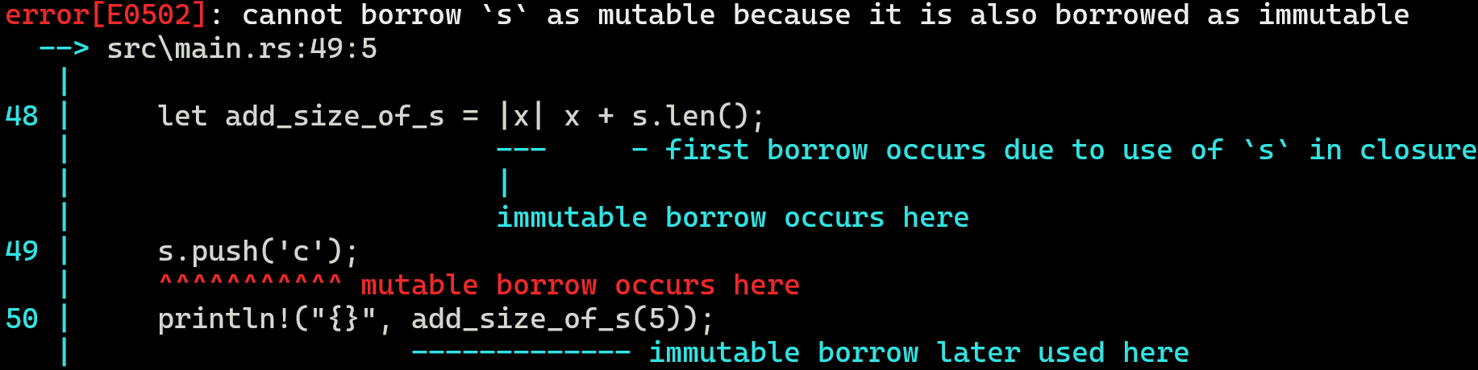
Closures

Slide 94
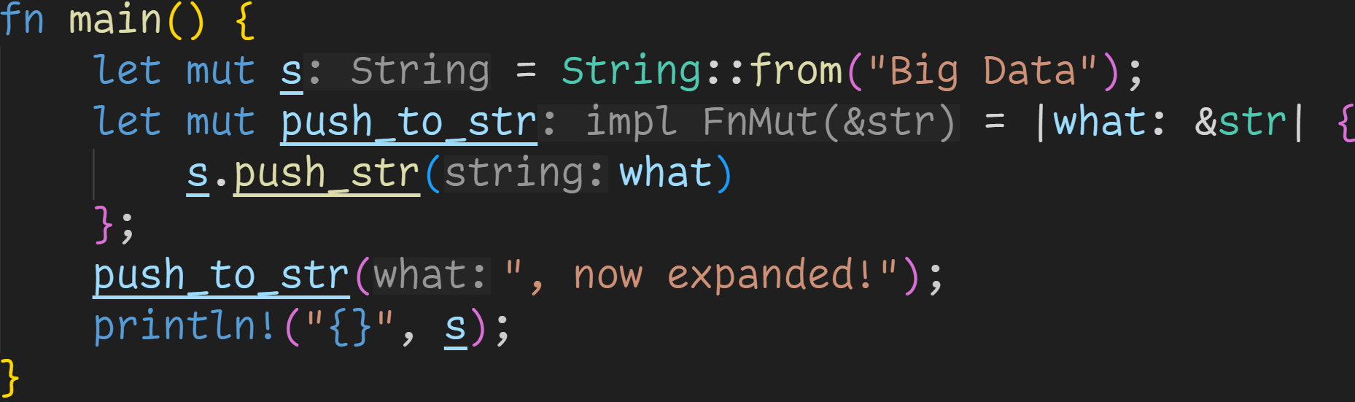
Closures
There are three traits that a closure can implement → Fn, FnMut, FnOnce

Slide 95
Closures
There are three traits that a closure can implement → Fn, FnMut, FnOnce
If we mutably borrow any outer variables, the closure implements FnMut

Slide 96
Closures
There are three traits that a closure can implement → Fn, FnMut, FnOnce
We modify s → We mutably borrow s

Slide 97
Closures
There are three traits that a closure can implement → Fn, FnMut, FnOnce
If we want to call a FnMut closure, the variable needs to be mutable

Slide 98
Closures
There are three traits that a closure can implement → Fn, FnMut, FnOnce
In this range we mutably borrow s

Slide 99
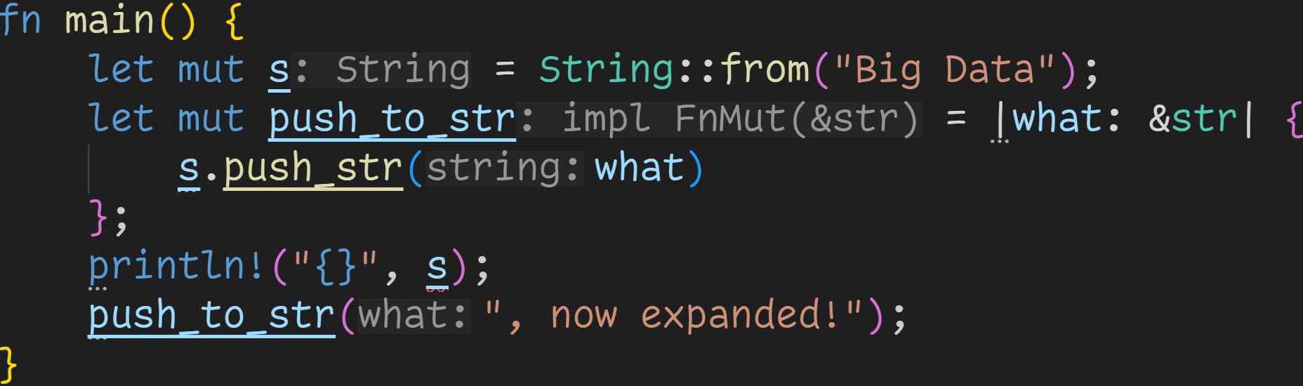
Closures
There are three traits that a closure can implement → Fn, FnMut, FnOnce

Slide 100
Closures
There are three traits that a closure can implement → Fn, FnMut, FnOnce
Mutable borrow here

Slide 101
Closures
There are three traits that a closure can implement → Fn, FnMut, FnOnce
Immutable borrow here
Mutable borrow here

Slide 102
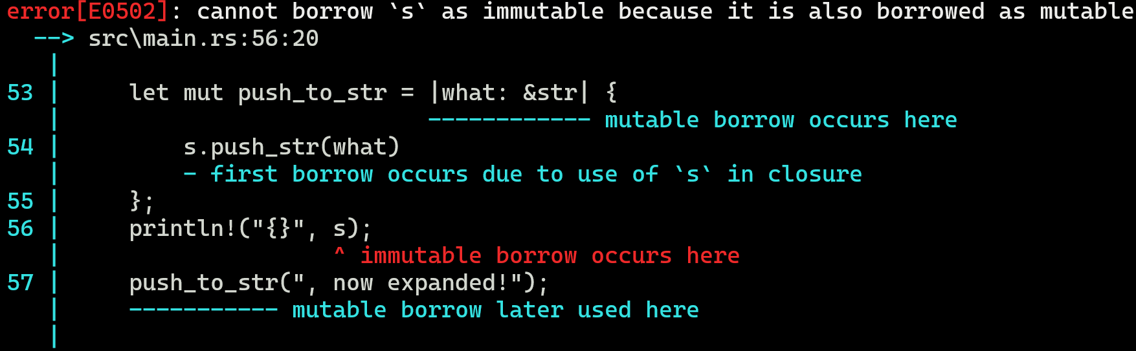
Closures

Slide 103
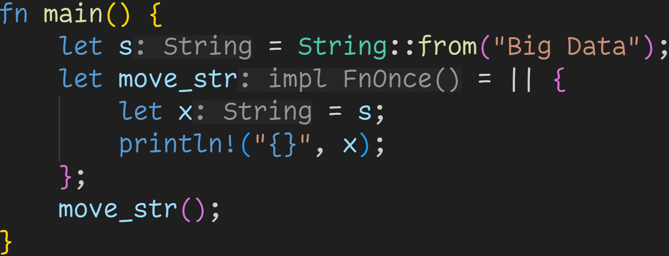
Closures
There are three traits that a closure can implement → Fn, FnMut, FnOnce

Slide 104
Closures
There are three traits that a closure can implement → Fn, FnMut, FnOnce
If we move any outer variables, the closure implements FnOnce

Slide 105
Closures
There are three traits that a closure can implement → Fn, FnMut, FnOnce
If we move any outer variables, the closure implements FnOnce
Because we move values, FnOnce closures can only be called once

Slide 106
Closures
There are three traits that a closure can implement → Fn, FnMut, FnOnce
String doesn‘t implement Copy, s is moved here

Slide 107
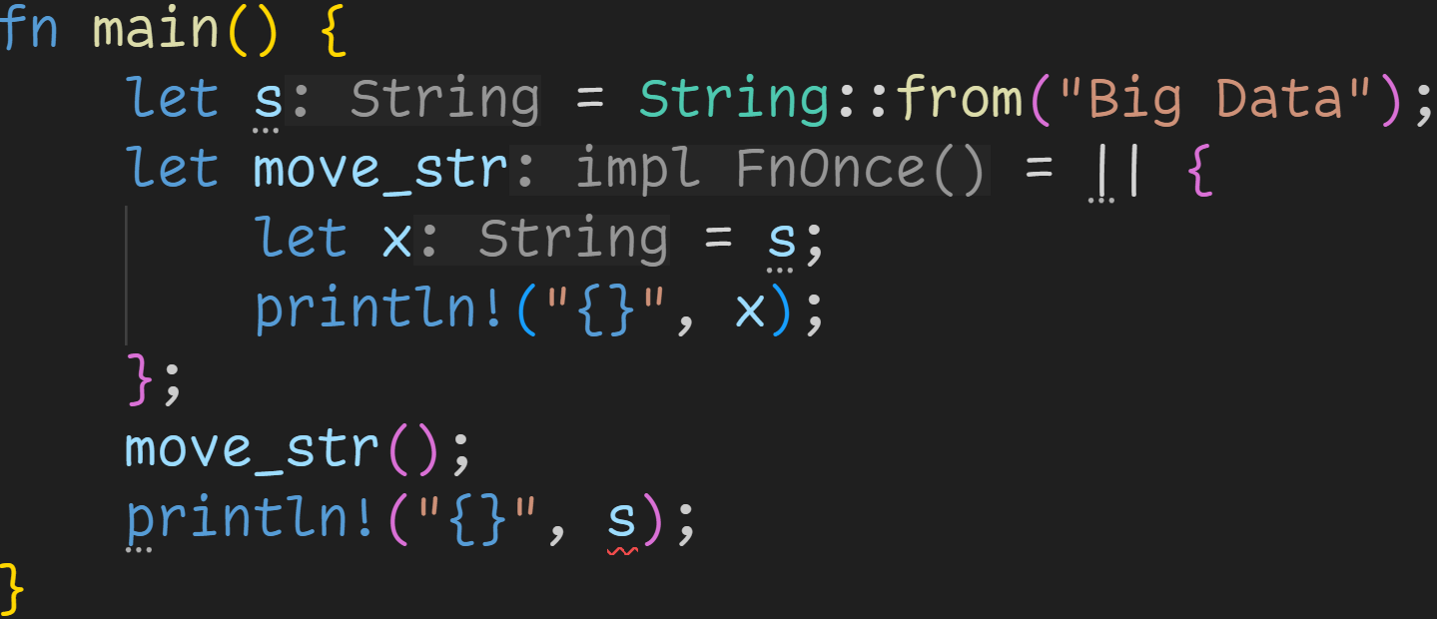
Closures
There are three traits that a closure can implement → Fn, FnMut, FnOnce

Slide 108
Closures
There are three traits that a closure can implement → Fn, FnMut, FnOnce
s moved here

Slide 109
Closures
There are three traits that a closure can implement → Fn, FnMut, FnOnce
s moved here
Can‘t use s here

Slide 110
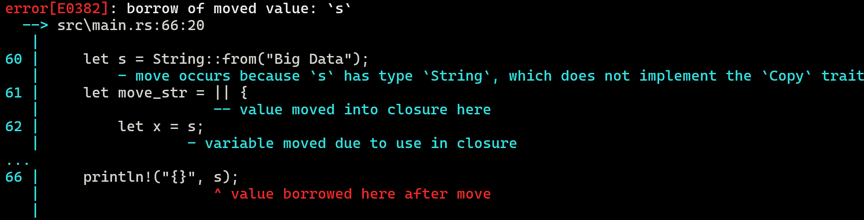
Closures

Slide 111
Closures
Those traits have additional trait boundaries → FnMut: FnOnce → Every FnMut is also FnOnce → Fn: FnMut → Every Fn is also FnMut → Every Fn is also FnOnce

Slide 112
Closures
Those traits have additional trait boundaries → FnMut: FnOnce → Every FnMut is also FnOnce → Fn: FnMut → Every Fn is also FnMut → Every Fn is also FnOnce
Fn
FnMut
FnOnce

Slide 113
Closures
Those traits have additional trait boundaries → FnMut: FnOnce → Every FnMut is also FnOnce → Fn: FnMut → Every Fn is also FnMut → Every Fn is also FnOnce → FnOnce is the most generic closure, every closure can be called at least once
Fn
FnMut
FnOnce

Slide 114
Closures
Those traits have additional trait boundaries → FnMut: FnOnce → Every FnMut is also FnOnce → Fn: FnMut → Every Fn is also FnMut → Every Fn is also FnOnce → FnOnce is the most generic closure, every closure can be called at least once
When writing functions that accept closures, it‘s recommended to always use the most generic trait

Slide 115
Closures
Those traits have additional trait boundaries → FnMut: FnOnce → Every FnMut is also FnOnce → Fn: FnMut → Every Fn is also FnMut → Every Fn is also FnOnce → FnOnce is the most generic closure, every closure can be called at least once
When writing functions that accept closures, it‘s recommended to always use the most generic trait → Function only expects to call the closure once → Mark parameter as FnOnce → Can still pass FnMut

Slide 116
Closures
Those traits have additional trait boundaries → FnMut: FnOnce → Every FnMut is also FnOnce → Fn: FnMut → Every Fn is also FnMut → Every Fn is also FnOnce → FnOnce is the most generic closure, every closure can be called at least once
When writing functions that accept closures, it‘s recommended to always use the most generic trait → Function only expects to call the closure once → Mark parameter as FnOnce → Can still pass FnMut → Closure might mutate its environment → Mark parameter as FnMut → Can still pass Fn

Slide 117
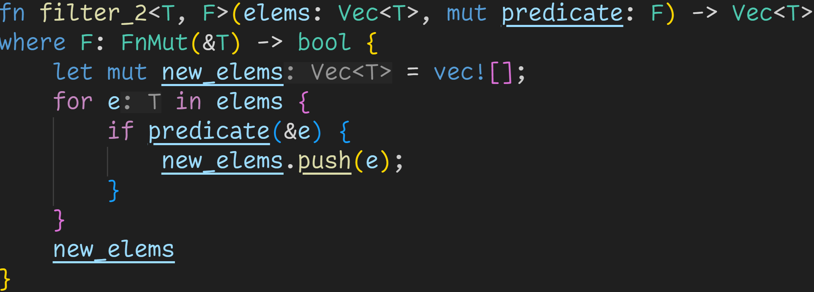
Closures

Slide 118
Closures
We accept every closure that can be called multiple times → We don‘t care if it modifies its environment

Slide 119
Closures
We accept every closure that can be called multiple times → We don‘t care if it modifies its environment → Can‘t accept FnOnce, because we call the closure more than once

Slide 120
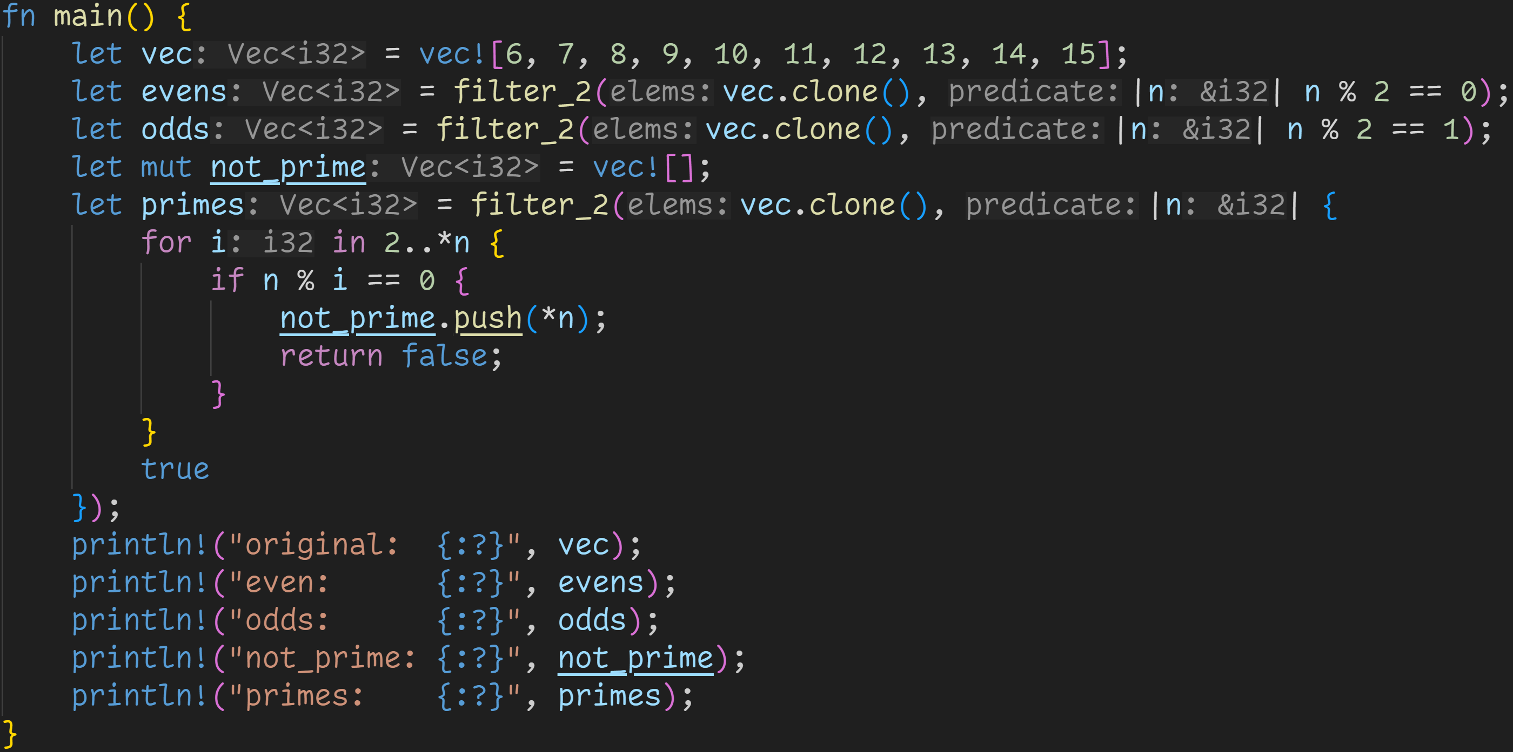
Closures

Slide 121
Closures
We can now call our filter-function with any closure that‘s FnMut

Slide 122
Closures
Fn-closures

Slide 123
Closures
This closure modifies the environment (it pushes elements to not_prime), so it is FnMut

Slide 124
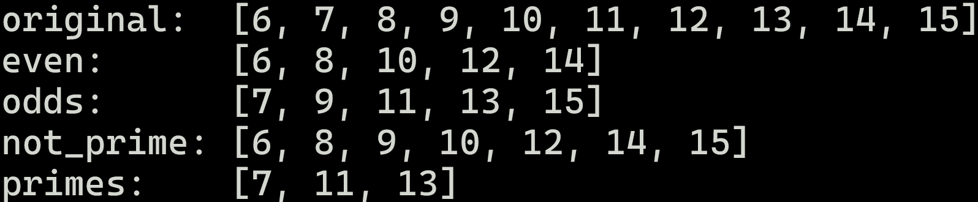
Closures

Slide 125
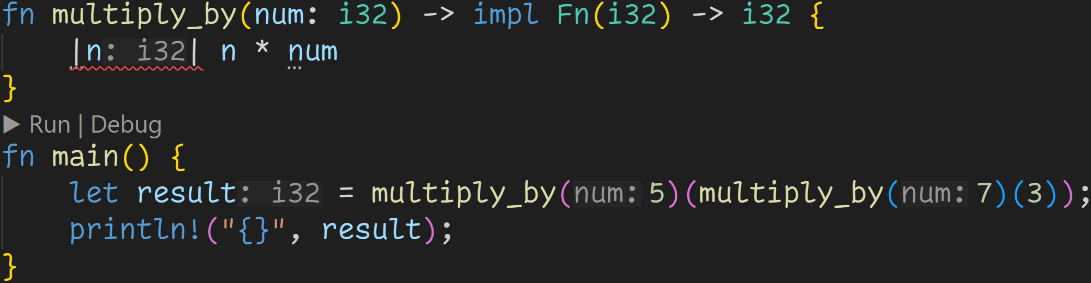
Closures

Slide 126
Closures
We can also return closures from functions

Slide 127
Closures
However, Fn only borrows variables
→ Closure would outlive num

Slide 128
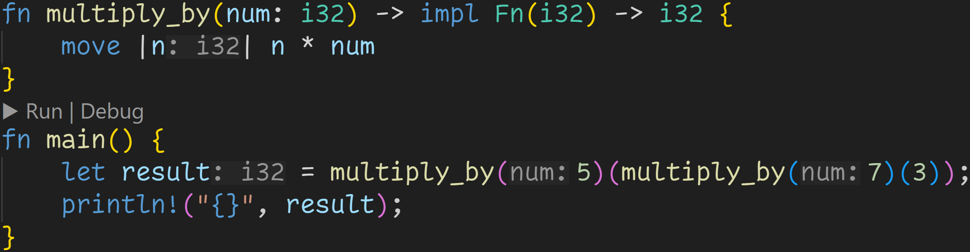
Closures
Instead of borrowing, we explicitly move all variables into the closure

Slide 129
Closures
Composing functions

Slide 130
Closures
Those function calls return closures

Slide 131
Closures
n * 7

Slide 132
Closures
3 * 7

Slide 133
Closures
3 * 7 * 5

Slide 134
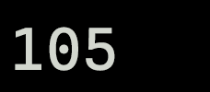
Closures
3 * 7 * 5

Slide 135
Iterators

Slide 136
Iterators
The next step in making closures useful is implementing data structures that work with them

Slide 137
Iterators
The next step in making closures useful is implementing data structures that work with them
Those data structures are called iterators

Slide 138
Iterators
The next step in making closures useful is implementing data structures that work with them
Those data structures are called iterators
Iterators only serve one purpose → Repeatedly emit the next item of a collection, until it is exhausted

Slide 139
Iterators
The next step in making closures useful is implementing data structures that work with them
Those data structures are called iterators
Iterators only serve one purpose → Repeatedly emit the next item of a collection, until it is exhausted
Every iterator implements the Iterator trait in which they define how the next item is obtained

Slide 140
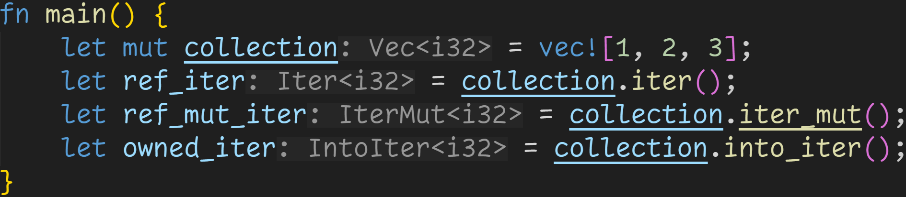
Iterators
There are three variations of iterators

Slide 141
Iterators
There are three variations of iterators
→ iter() creates an iterator over immutable references of the elements

Slide 142
Iterators
There are three variations of iterators
→ iter() creates an iterator over immutable references of the elements → iter_mut() creates an iterator over mutable references of the elements

Slide 143
Iterators
There are three variations of iterators
→ iter() creates an iterator over immutable references of the elements → iter_mut() creates an iterator over mutable references of the elements → into_iter() creates an iterator over owned elements

Slide 144
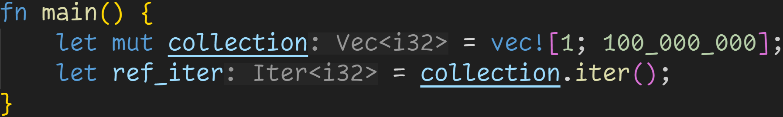
Iterators
Iterators are lazy → They only compute elements when you consume them

Slide 145
Iterators
Iterators are lazy → They only compute elements when you consume them
Creating an iterator over 100 million elements → Super fast because we‘re not doing anything with it

Slide 146
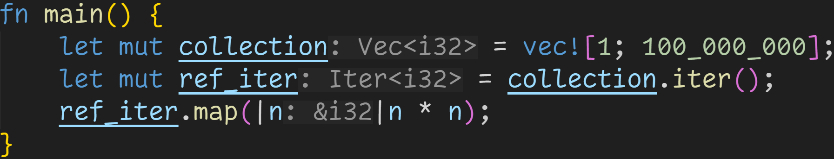
Iterators

Slide 147
Iterators
Iterators come with many different methods → map and filter are some of them

Slide 148
Iterators
Iterators come with many different methods → map and filter are some of them map() returns an iterator over all elements of the original collection when applied to the given closure → map() is also lazy, it does not do anything until consumed

Slide 149
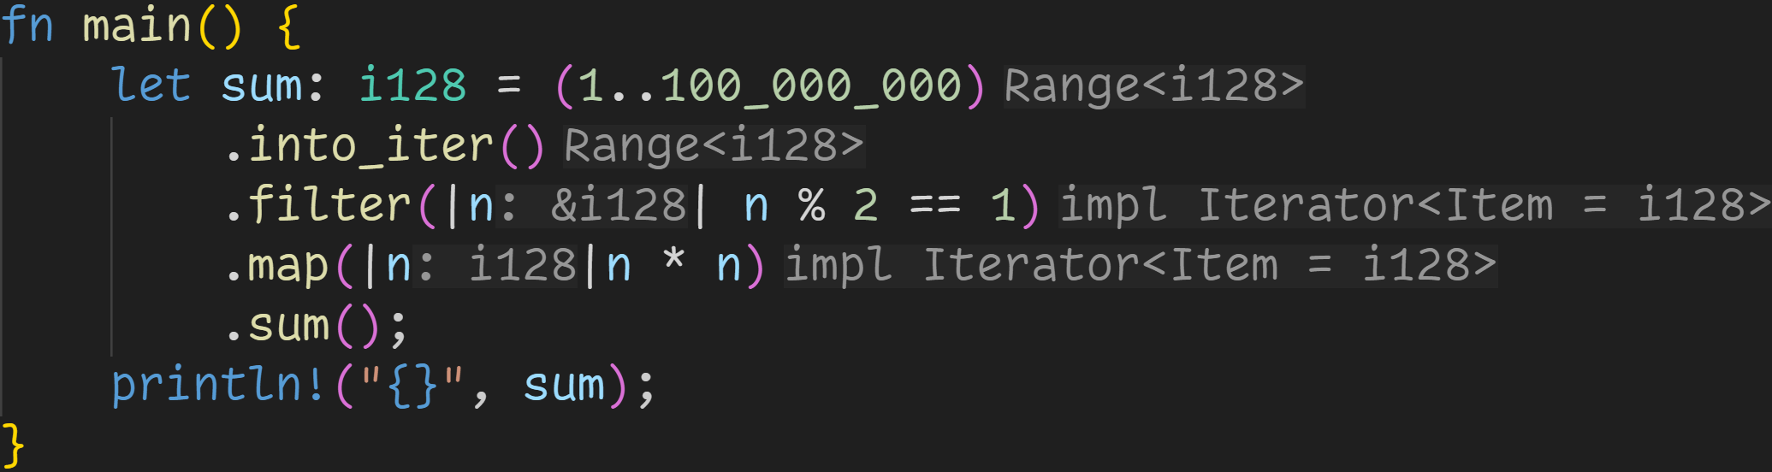
Iterators

Slide 150
Iterators
Because many iterator-methods are lazy and return iterators, we can easily chain those calls → Iterator adaptors → Function composition

Slide 151
Iterators
sum() consumes the iterator, now we start computing elements

Slide 152
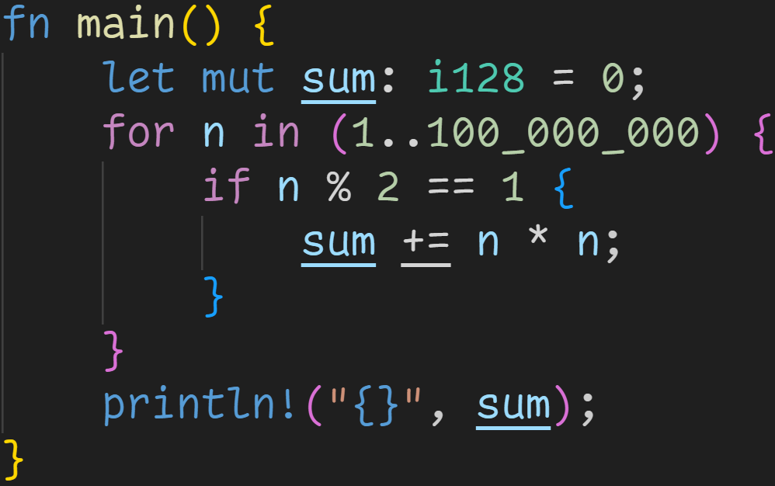
Iterators
This iterator-chain is equivalent to this for-loop

Slide 153
Iterators
This iterator-chain is equivalent to this for-loop

Slide 154
Iterators
for also implicitly calls into_iter() for us → Moves the collection → That‘s why we need to borrow collections
This iterator-chain is equivalent to this for-loop

Slide 155
Iterators
This iterator-chain is equivalent to this for-loop

Slide 156
Iterators
This iterator-chain is equivalent to this for-loop

Slide 157
Iterators
This iterator-chain is equivalent to this for-loop

Slide 158

Iterators

Slide 159
Iterators
Because all elements of iterators are decoupled, we can easily parallelize them

Slide 160
Iterators
The crate rayon makes it super easy to add parallelism to our iterators
→ Easy extra performance by just changing a single line
Because all elements of iterators are decoupled, we can easily parallelize them

Slide 161

Iterators

Slide 162
Iterators
The only difference in this iterator chain

Slide 163


Iterators

Slide 164

Iterators

Slide 165
Iterators
Find the first element that has a value of 3

Slide 166

Iterators

Slide 167
Iterators
Find the first element that has a value of 3
→ Iterators allow us to write more concise and readable code

Slide 168

Iterators

Slide 169
Iterators
Iterators can go on forever, which means we can implement infinite data structures

Slide 170
Iterators
This iterator goes over every number that fits in an u128, and prints every prime

Slide 171
Iterators
To check if a number is prime:
Take all odd numbers

Slide 172
Iterators
To check if a number is prime:
Take all odd numbers that are smaller than the square root of the candidate

Slide 173
Iterators
To check if a number is prime:
Take all odd numbers that are smaller than the square root of the candidate and check that they don‘t divide the candidate

Slide 174
Iterators
all is short-circuiting
→ It stops iterating once it finds an element that returns false

Slide 175
Iterators
If this iterator hits the end of u128, two things can happen
→ Debug mode: Panic
→ Release mode: Overflow and start at 0 again

Slide 176

Iterators
some prime numbers:
At the same time, iterators are memory efficient, at any point we only store two numbers:
The prime candidate, and the number we‘re currently checking against

Slide 177

Iterators

Slide 178
Iterators
Implement Container::try_from(i32), which only accepts numbers above 10

Slide 179
Iterators
Create an iterator to easily build a vector of containers

Slide 180
Iterators
Problem: .unwrap() is not good practice, we‘d like to report the error

Slide 181

Iterators

Slide 182
Iterators
.unwrap() is gone, but we now have a Vector of Results!

Slide 183
Iterators
.unwrap() is gone, but we now have a Vector of Results!
→ collect() comes with a lot of useful overloads

Slide 184

Iterators

Slide 185
Iterators
collect() can be called with any generic types that implement the FromIterator trait
→ Result<T, E> does implement that trait!

Slide 186
Iterators
collect() can be called with any generic types that implement the FromIterator trait
→ Result<T, E> does implement that trait! → If the iterator contains an Err()-element, we stop directly and return the Err() → If all elements are Ok(), we transform Vec<Ok> into Ok<Vec>

Slide 187

Iterators

Slide 188
Iterators
inspect() allows us to see what element the iterator is currently processing

Slide 189
Iterators
Because we‘re now collecting into a Result, we can use the ?-operator

Slide 190

Iterators
Our first element directly caused an error, so we did not advance the iterator further

Slide 191

Iterators
Change range to something more reasonable

Slide 192

Iterators
We successfully iterate over all numbers and build containers!

Slide 193
Next time
Multithreading

